Slide 1
Brain-Inspired Continual Learning: Rethinking the Role of Features in the Stability-Plasticity Dilemma
Ph.D. Dissertation Defense
Hikmat Khan
April 15, 2024
Committee:
Dr. Nidhal C. Bouaynaya, Ph.D.
Dr. Ghulam Rasool, Ph.D.
Dr. Ravi P. Ramachandran, Ph.D.
Dr. Robi Polikar, Ph.D.
Dr. Shlomo Engelberg, Ph.D.
Notes:
qfw

Slide 2
Outline
Introduction
Continual Learning
Related Work
Research Questions
Our Work: A Multidisciplinary Approach
Primary Contributions
Adversarially Robust Continual Learning
The Importance of Robust Features in Mitigating Catastrophic Forgetting
Brain-Inspired Continual Learning Robust Feature Distillation and Re-consolidation for Class Incremental Learning
Adversarially Diversified Rehearsal Memory (ADRM): Mitigating Memory Overfitting Challenge in Continual Learning
Conclusions
Future Work

Slide 3
Outline
Introduction | Related Work | Research Questions | Our Work: A Multidisciplinary Approach | Primary Contributions| Conclusions
Introduction
Continual Learning
Related Work
Research Questions
Our Work: A Multidisciplinary Approach
Primary Contributions
Adversarially Robust Continual Learning
The Importance of Robust Features in Mitigating Catastrophic Forgetting
Brain-Inspired Continual Learning Robust Feature Distillation and Re-consolidation for Class Incremental Learning
Adversarially Diversified Rehearsal Memory (ADRM): Mitigating Memory Overfitting Challenge in Continual Learning
Conclusions
Future work

Slide 4
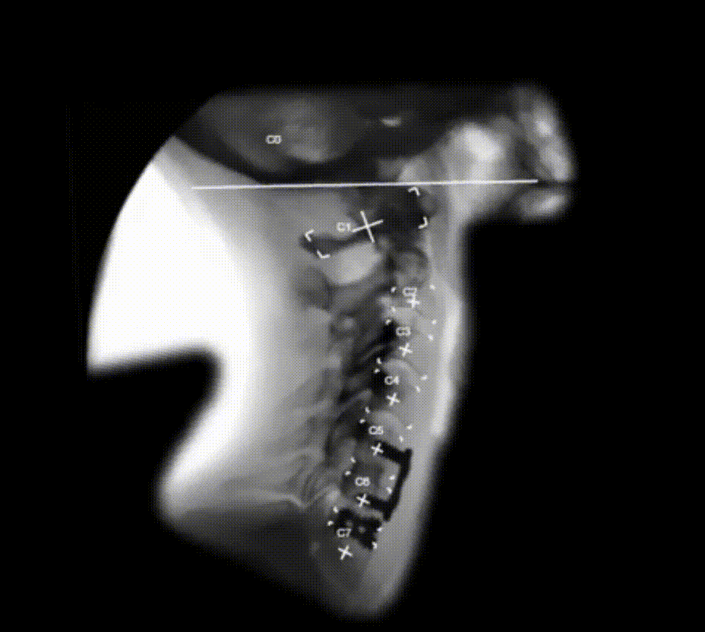
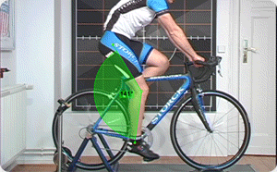
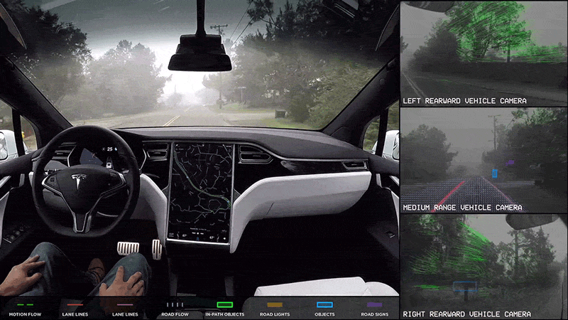
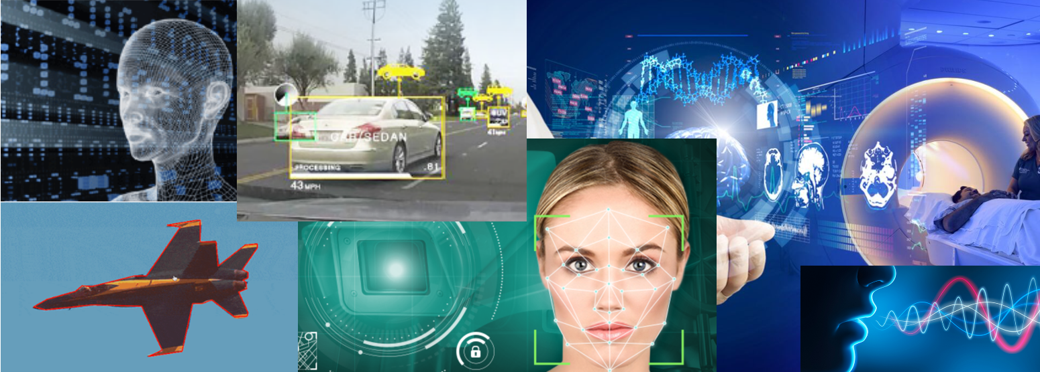
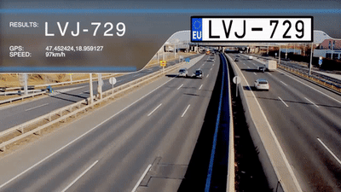
Deep Learning – The Promise
Introduction | Related Work | Research Questions | Our Work: A Multidisciplinary Approach | Primary Contributions| Conclusions
Deep Learning (DL)/Artificial Intelligence (AI) models have achieved or even surpassed human-level accuracy in several areas, including computer vision and pattern recognition.
Notes:
Joint learning or Offline learning
We want our model to learn all the tasks simultaneously
Continual Learning
We want our model to learn them sequentially, without forgetting.
Doctor:
Perform surgery
Ride the bike back home, without getting any speeding ticket
Unlike Human:
Deep learning model tend to forget the previously learned capabilities
Continual learning is the cornerstone of realizing the longstanding dream of AGI.

Slide 5
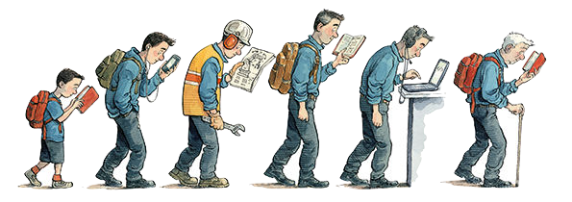
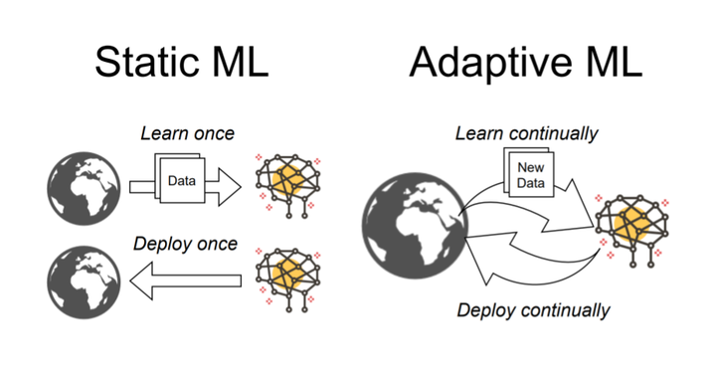
The World is Non-Stationary [5]
Introduction | Related Work | Research Questions | Our Work: A Multidisciplinary Approach | Primary Contributions| Conclusions
https://medium.com/gooroo-official/if-youre-not-learning-you-re-dying-b2b4d54eace4 | https://senicessm.live/product_details/47625942.html
Notes:
Lifelong learning and adaptability are the only ways to realize AGI's longstanding dream.

Slide 6
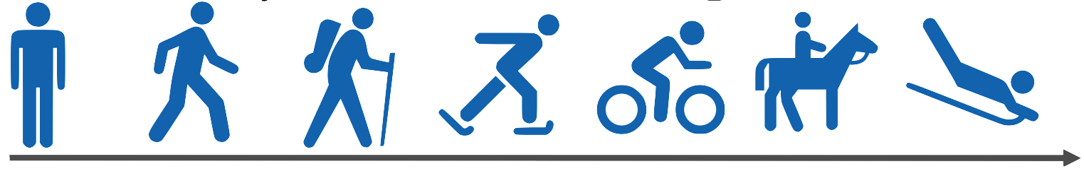

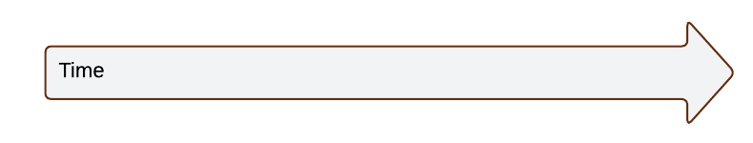
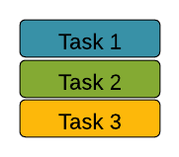
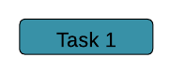
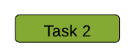

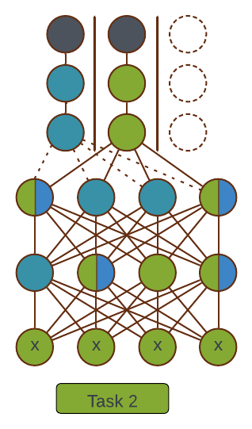
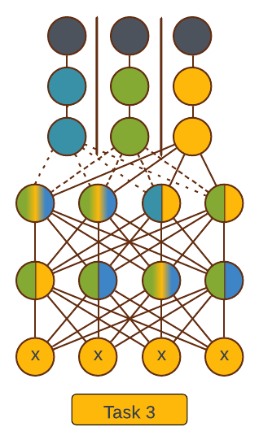
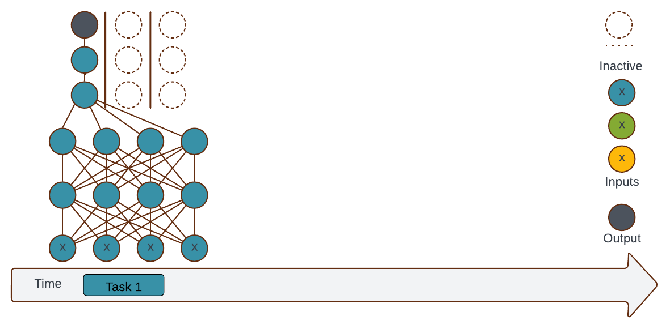
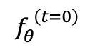
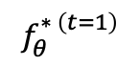
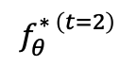
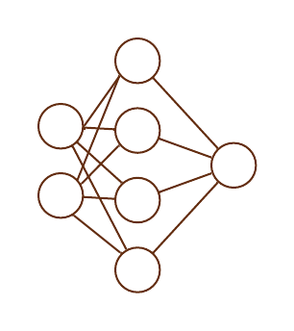
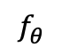
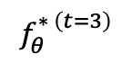
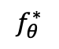
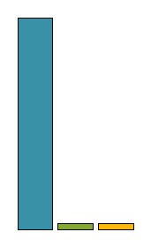
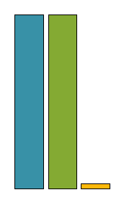
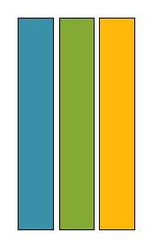
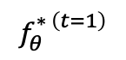
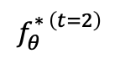
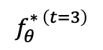
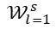
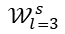
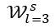
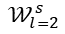
Continual Learning (CL)
Introduction | Related Work | Research Questions | Our Work: A Multidisciplinary Approach | Primary Contributions| Conclusions
Learning tasks over time[1].
The tasks can be any classification or segmentation.
Offline learning [1, 2].
Learn all tasks simultaneously.
time
Learning tasks
Perform tasks
Task Incremental Learning [2]
$$𝒲_{l=3}^{s}$$
$$𝒲_{l=3}^{s}$$
$$𝒲_{l=3}^{s}$$
$$𝒲_{l=2}^{s}$$
$$𝒲_{l=2}^{s}$$
$$𝒲_{l=2}^{s}$$
$$𝒲_{l=1}^{s}$$
$$𝒲_{l=1}^{s}$$
$$𝒲_{l=1}^{s}$$
Average Performance
Average Performance
Average Performance
Knowledge accumulation over time
Joint learning
Knowledge accumulation over time
Notes:
Task Incremental Learning
Also known as multi-head settings
Each task has its own unique set of features and output units
Task identity is required [2]
Given permutation $𝒳$, which digits?

Slide 7
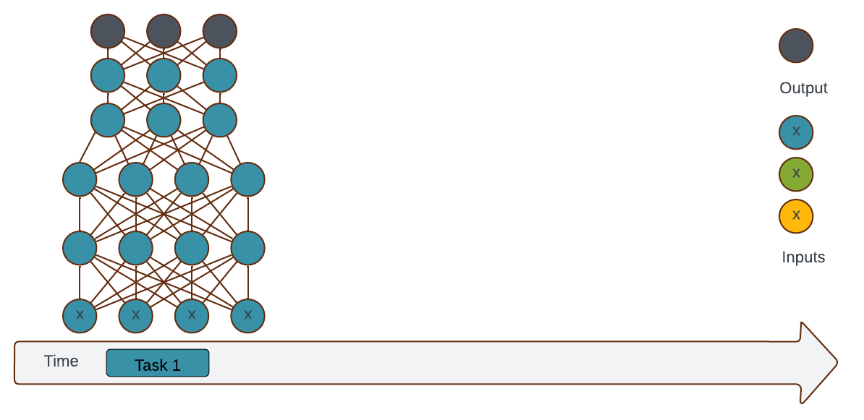
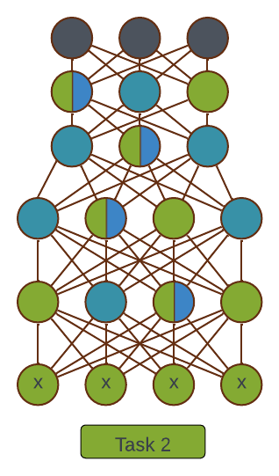
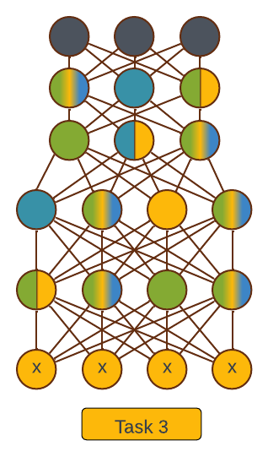
Continual Learning (CL) (Continued)
Introduction | Related Work | Research Questions | Our Work: A Multidisciplinary Approach | Primary Contributions| Conclusions
Learning tasks over time[1].
The tasks can be any classification or segmentation.
Offline learning [1, 2].
Learn all tasks simultaneously.
time
Learning tasks
Perform tasks
Domain Incremental Learning [2]
$$𝒲_{l=3}^{s}$$
$$𝒲_{l=3}^{s}$$
$$𝒲_{l=3}^{s}$$
$$𝒲_{l=2}^{s}$$
$$𝒲_{l=2}^{s}$$
$$𝒲_{l=2}^{s}$$
$$𝒲_{l=1}^{s}$$
$$𝒲_{l=1}^{s}$$
$$𝒲_{l=1}^{s}$$
Average Performance
Average Performance
Average Performance
Knowledge accumulation over time
Joint learning
Knowledge accumulation over time
Notes:
Domain Incremental Learning
Train on a sequence of related domains
Task identity is not required [2]
With permutation unknown, which digit?

Slide 8
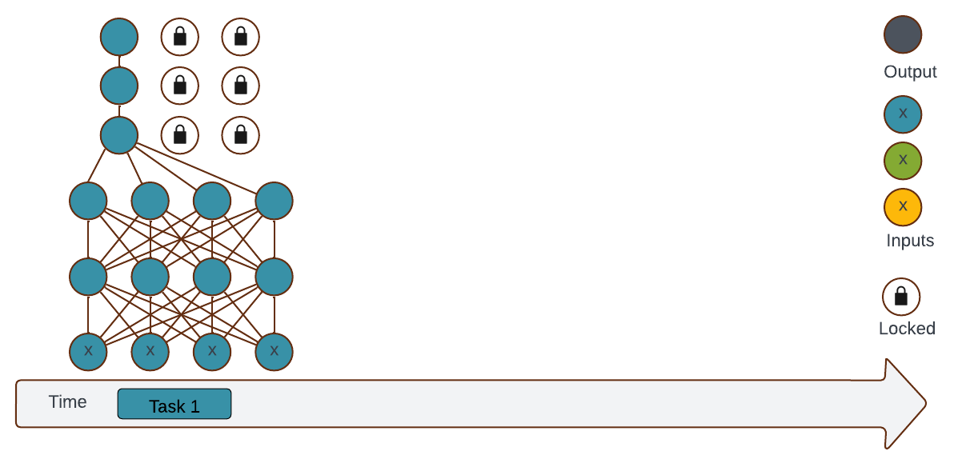
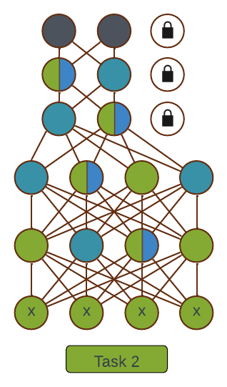
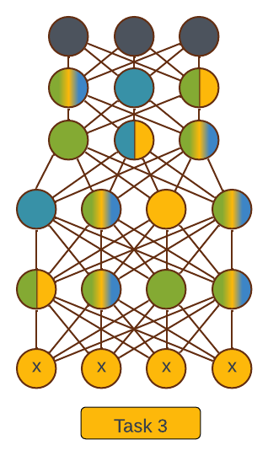
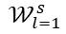
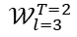
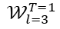
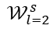
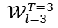
Continual Learning (CL) (Continued)
Introduction | Related Work | Research Questions | Our Work: A Multidisciplinary Approach | Primary Contributions| Conclusions
Learning tasks over time[1].
The tasks can be any classification or segmentation.
Offline learning [1, 2].
Learn all tasks simultaneously.
time
Learning tasks
Perform tasks
Class Incremental Learning [2]
$$𝒲_{l=3}^{T=1}$$
$$𝒲_{l=3}^{T=2}$$
$$𝒲_{l=3}^{T=3}$$
$$𝒲_{l=2}^{s}$$
$$𝒲_{l=2}^{s}$$
$$𝒲_{l=2}^{s}$$
$$𝒲_{l=1}^{s}$$
$$𝒲_{l=1}^{s}$$
$$𝒲_{l=1}^{s}$$
Average Performance
Average Performance
Average Performance
Knowledge accumulation over time
Joint learning
Knowledge accumulation over time
Notes:
Class Incremental Learning
Also, know single-head settings
Infer the task identify (No task identification required)[2]
Which digit and which permutation?

Slide 9
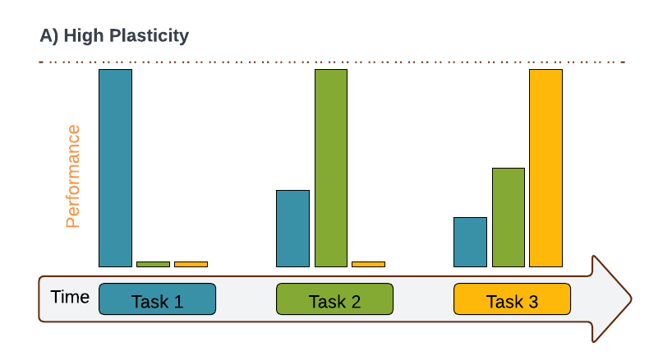
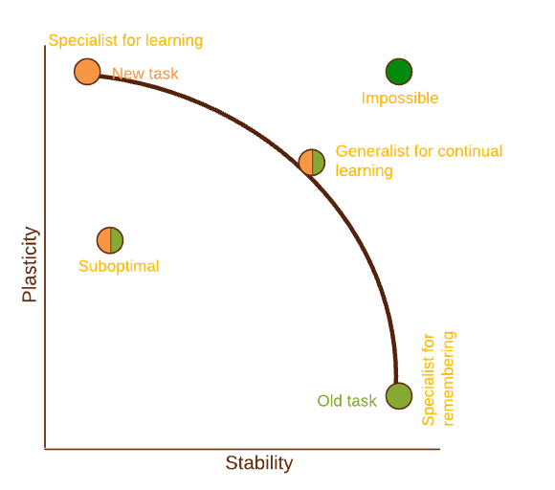
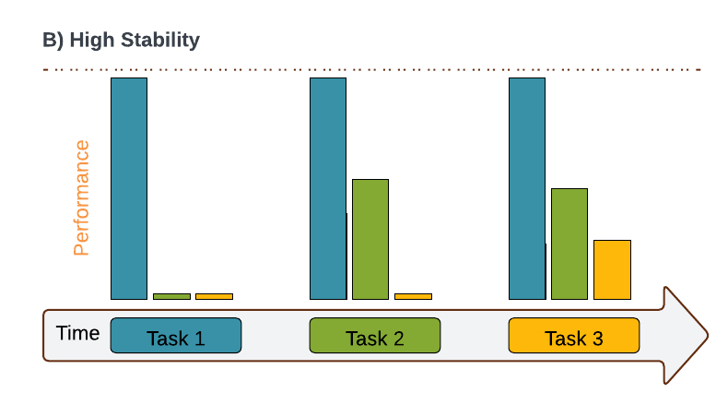
Challenges: What is Stopping CL
Introduction | Related Work | Research Questions | Our Work: A Multidisciplinary Approach | Primary Contributions| Conclusions
The plasticity and stability dilemma [3].
The plasticity-stability dilemma is a fundamental challenge in both neuroscience and deep learning design.
High Plasticity
Balance is crucial!
High stability
Notes:
Plasticity-stability dilemma
The plasticity-stability dilemma is a fundamental challenge in both neuroscience and deep learning design
It refers to the trade-off between
Plasticity—the ability of a system to learn and adapt to new experiences.
Stability, which is the system's ability to retain previously learned information.
If a system is too plastic, it risks overriding old knowledge (a problem known as catastrophic forgetting) when new information is learned.
Conversely, if a system is too stable, it becomes rigid and unable to incorporate new knowledge effectively.
Balancing these two aspects is crucial for creating models that can learn continuously and effectively over time.

Slide 10
Challenges: What is Stopping CL
Introduction | Related Work | Research Questions | Our Work: A Multidisciplinary Approach | Primary Contributions| Conclusions
The plasticity and stability dilemma [3].
Plasticity:
Easily learn and adapt to new experiences.
Enables good adaptation.
Stability:
Ability to retain previously learned experiences.
Ensures proficiency in solving old tasks.
Catastrophic forgetting [4].
If a system is too plastic, it risks overriding old knowledge (aka catastrophic forgetting)
A phenomenon where a model forgets previously learned knowledge after acquiring new knowledge.
Notes:
Plasticity-stability dilemma
The plasticity-stability dilemma is a fundamental challenge in both neuroscience and deep learning design
It refers to the trade-off between
Plasticity—the ability of a system to learn and adapt to new experiences.
Stability, which is the system's ability to retain previously learned information.
If a system is too plastic, it risks overriding old knowledge (a problem known as catastrophic forgetting) when new information is learned.
Conversely, if a system is too stable, it becomes rigid and unable to incorporate new knowledge effectively.
Balancing these two aspects is crucial for creating models that can learn continuously and effectively over time.

Slide 11
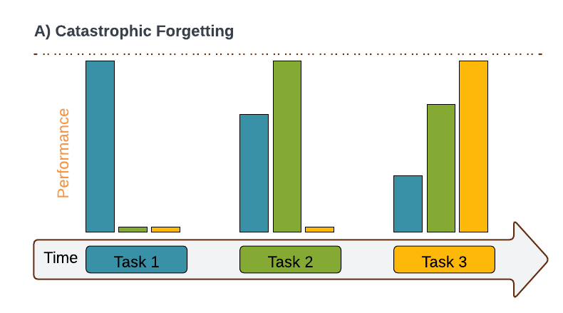
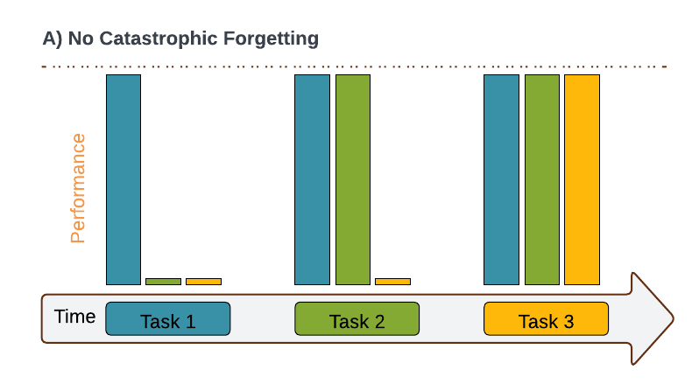
Challenges Stopping CL
Introduction | Related Work | Research Questions | Our Work: A Multidisciplinary Approach | Primary Contributions| Conclusions
The plasticity and stability dilemma [3].
Plasticity:
Easily learn and adapt to new experiences.
Enables good adaptation.
Stability:
Ability to retain previously learned experiences.
Ensures proficiency in solving old tasks.
Catastrophic forgetting [4].
High Plasticity
Balance is crucial!
High Stability
High Plasticity
Balance is Crucial!
Ideal
Notes:
Balancing these two aspects is crucial for creating models that can learn continuously and effectively over time.

Slide 12
Outline
Introduction | Related Work | Research Questions | Our Work: A Multidisciplinary Approach | Primary Contributions| Conclusions
Introduction
Continual Learning
Related Work
Research Questions
Our Work: A Multidisciplinary Approach
Primary Contributions
Adversarially Robust Continual Learning
The Importance of Robust Features in Mitigating Catastrophic Forgetting
Brain-Inspired Continual Learning Robust Feature Distillation and Re-consolidation for Class Incremental Learning
Adversarially Diversified Rehearsal Memory (ADRM) Mitigating Memory Overfitting Challenge in Continual Learning
Conclusions
Future Work
Notes:
Adversarial Examples are not Bugs, They are Features

Slide 13
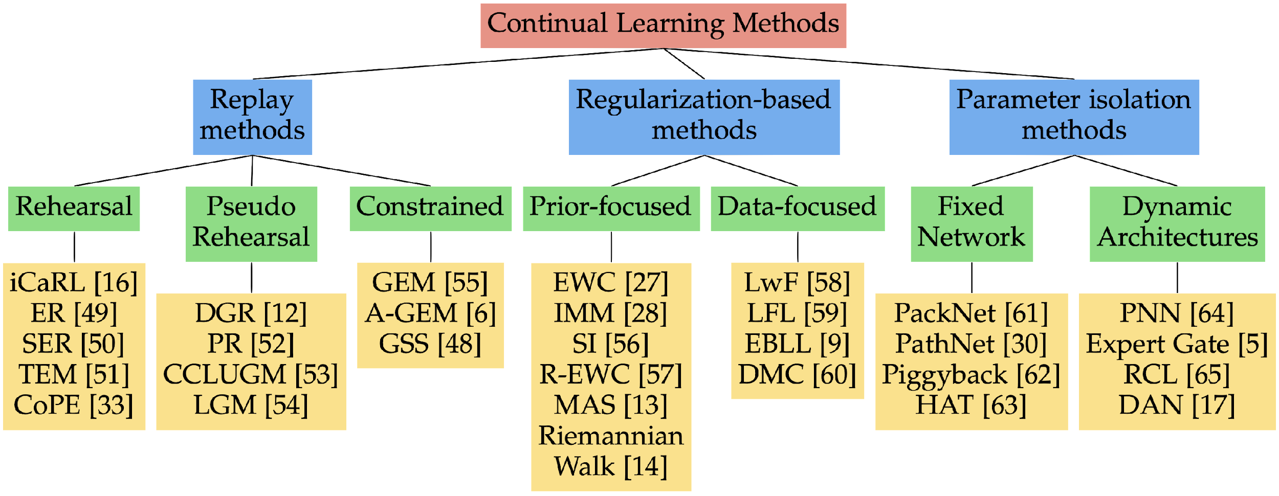
Related Work
Introduction | Related Work | Research Questions | Our Work: A Multidisciplinary Approach | Primary Contributions| Conclusions
Rehearsal-based Approaches [1, 5]
Store a subset of the old data and rehearse it during
the learning of the subsequent tasks.
Regularization-based Approaches [1, 5]
Penalize (important) parameter updates.
Architectural-based Approaches [1, 5]
Increase the model capacity for every new task.
Explicitly identify important parameters for each task.
Knowledge Distillation-based Approaches [1, 5]
Take inspiration from the Knowledge Distillation.
Use the previous task model as a teacher.
Dataset Distillation-based Approaches [1, 5]
Create representative subsets that can be rehearsed during the learning of the subsequent tasks.
Brain-inspired Approaches [1, 5]
Incorporate inspiration from neuroscience in designing the CL
Hybrid Approaches [1, 5]
Combine multiple approaches to create more robust solutions against catastrophic forgetting.

Slide 14
Outline
Introduction| Related Work | Research Questions | Our Work: A Multidisciplinary Approach | Primary Contributions| Conclusions
Introduction
Continual Learning
Related Work
Research Questions
Our Work: A Multidisciplinary Approach
Primary Contributions
Adversarially Robust Continual Learning
The Importance of Robust Features in Mitigating Catastrophic Forgetting
Brain-Inspired Continual Learning Robust Feature Distillation and Re-consolidation for Class Incremental Learning
Adversarially Diversified Rehearsal Memory (ADRM): Mitigating Memory Overfitting Challenge in Continual Learning
Conclusions
Future Work
Notes:
Adversarial Examples are not Bugs, They are Features

Slide 15
Research Questions
Introduction| Related Work | Research Questions | Our Work: A Multidisciplinary Approach | Primary Contributions| Conclusions
What is the role of features (in the input dataset) in the robustness and mitigation of catastrophic forgetting in the CL? [6]
Can disentangled CL-robust features be used to train the CL model to mitigate catastrophic forgetting? [7]
Can neuroscience insights on memory consolidation, reconsolidation, and dataset distillation be integrated into CL approach design? [8]
Can rehearsal memory be diversified to prevent rehearsal memory overfitting in CL models? [9]

Slide 16
Outline
Introduction| Related Work | Research Questions | Our Work: A Multidisciplinary Approach | Primary Contributions| Conclusions
Introduction
Continual Learning
Related Work
Research Questions
Our Work: A Multidisciplinary Approach
Primary Contributions
Adversarially Robust Continual Learning
The Importance of Robust Features in Mitigating Catastrophic Forgetting
Brain-Inspired Continual Learning Robust Feature Distillation and Re-consolidation for Class Incremental Learning
Adversarially Diversified Rehearsal Memory (ADRM): Mitigating Memory Overfitting Challenge in Continual Learning
Conclusions
Future Work
Notes:
Adversarial Examples are not Bugs, They are Features

Slide 17
Our Work: A Multidisciplinary Approach
Introduction| Related Work | Research Questions | Our Work: A Multidisciplinary Approach | Primary Contributions| Conclusions
Our work is the first to integrate insights from Adversarial Machine Learning (AML), Dataset Distillation (or Condensation), Neuroscience, and CL to mitigate catastrophic forgetting.
AML
Robust features
Non-robust features
Dataset Distillation
Synthetic samples
OUR
WORK
Neuroscience
Distill episodic memory
Memory Consolidation
Memory re-consolidation
CL
Rehearsal-based
approach
Notes:
Neuroscience
Distilling episodic memory: The brain abstracts and integrates specific episodic memories (memories of personal experiences) into more generalized knowledge or schemas.
During this distillation, the brain filters out the non-essential details of individual experiences while retaining the core, meaningful information.

Slide 18
Outline
Introduction | Related Work | Research Questions | Our Work: A Multidisciplinary Approach | Primary Contributions #1 | Conclusions
Introduction
Continual Learning
Related Work
Research Questions
Our Work: A Multidisciplinary Approach
Primary Contributions
Adversarially Robust Continual Learning
The Importance of Robust Features in Mitigating Catastrophic Forgetting
Brain-Inspired Continual Learning Robust Feature Distillation and Re-consolidation for Class Incremental Learning
Adversarially Diversified Rehearsal Memory (ADRM): Mitigating Memory Overfitting Challenge in Continual Learning
Conclusions
Future Work
Notes:
Adversarial Examples are not Bugs, They are Features

Slide 19
Adversarially Robust Continual Learning What is the role of features (in the input dataset) in the robustness and mitigation of catastrophic forgetting in the CL?
Introduction | Related Work | Research Questions | Our Work: A Multidisciplinary Approach | Primary Contributions #1 | Conclusions
1.
Hikmat. K, et all, "Adversarially Robust Continual Learning," 2022 International Joint Conference on Neural Networks (IJCNN), Padua, Italy, 2022, pp. 1-8, doi: 10.1109/IJCNN55064.2022.9892970.

Slide 20
What is the role of features (in the input dataset) in the robustness and mitigation of catastrophic forgetting in the CL?
Introduction | Related Work | Research Questions | Our Work: A Multidisciplinary Approach | Primary Contributions #1 | Conclusions
1.
Hikmat. K, et all, "Adversarially Robust Continual Learning," 2022 International Joint Conference on Neural Networks (IJCNN), Padua, Italy, 2022, pp. 1-8, doi: 10.1109/IJCNN55064.2022.9892970.

Slide 21
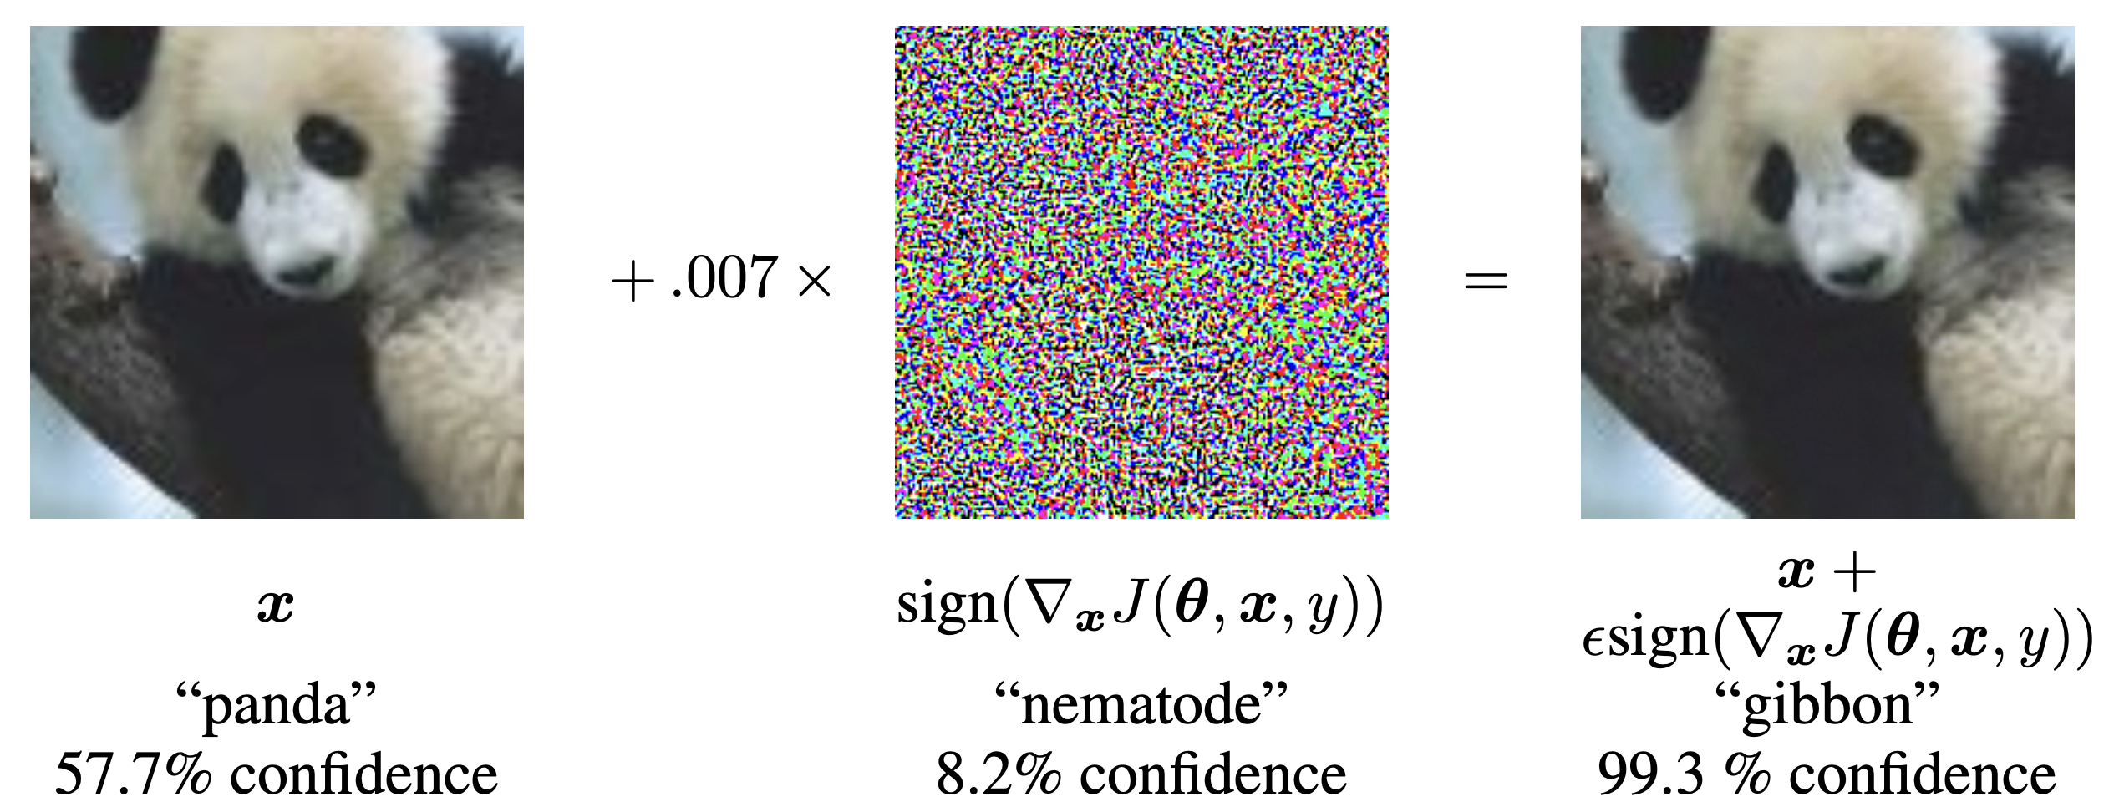

Introduction | Related Work | Research Questions | Our Work: A Multidisciplinary Approach | Primary Contributions #1 | Conclusions
Adversarial Examples are not Bugs, They are Features
Fast Gradient Sign Method (FGSM) [10]
$$x_{adv}=x+ε∗sign(Δ_{x} J\left(θ, x, y\right))$$

Slide 22









Adversarial Examples are not Bugs, They are Features (Continued)
Introduction | Related Work | Research Questions | Our Work: A Multidisciplinary Approach | Primary Contributions #1 | Conclusions
Adversarial vulnerability is a direct result of models’ sensitivity to well-generalizing features in the dataset [11].
It is possible to disentangle robust from non-robust features in standard datasets [11].
Robust dataset
Train
Good standard accuracy
frog
Good robust accuracy
Training image
Relabel as cat
Evaluate on original test set
Adversarial example towards “cat”
Unmodified
Test set
$$\max{P(cat)}$$
Train
frog
dog
cat
cat
Training dataset
Good standard accuracy
Robust Features: dog
Robust Features: dog
Good standard accuracy
Train
bad robust accuracy
Non-Robust Features: dog
Non-Robust Features: cat
frog
Constructed a dataset that appears mislabeled to humans (via adversarial examples) but results in good accuracy on the original test set
Non-robust dataset
Standard and robust accuracy on the CIFAR-10 test set ($𝒟$) for models trained with: (i) standard training (on$𝒟$) ; (ii) standard training on $\hat{𝒟_{NR}}$; (iii) adversarial training (on $𝒟$); and (iv) standard training on $\hat{𝒟_{R}}$.
Disentangle features into robust and non-robust

Slide 23


Adversarial Examples are not Bugs, They are Features (Continued)
Introduction | Related Work | Research Questions | Our Work: A Multidisciplinary Approach | Primary Contributions #1 | Conclusions
Adversarial vulnerability is a direct result of models’ sensitivity to well-generalizing features in the dataset [11].
It is possible to disentangle robust from non-robust features in standard datasets [11].
Robust dataset
Train
Good standard accuracy
frog
Good robust accuracy
Training image
Relabel as cat
Evaluate on original test set
Adversarial example towards “cat”
Unmodified
Test set
$$\max{P(cat)}$$
Train
frog
dog
cat
cat
Training dataset
Good standard accuracy
Robust Features: dog
Robust Features: dog
Good standard accuracy
Train
bad robust accuracy
Non-Robust Features: dog
Non-Robust Features: cat
frog
Constructed a dataset that appears mislabeled to humans (via adversarial examples) but results in good accuracy on the original test set
Non-robust dataset
Standard and robust accuracy on the CIFAR-10 test set ($𝒟$) for models trained with: (i) standard training (on$𝒟$) ; (ii) standard training on $\hat{𝒟_{NR}}$; (iii) adversarial training (on $𝒟$); and (iv) standard training on $\hat{𝒟_{R}}$.
Disentangle features into robust and non-robust

Slide 24

Adversarial Examples are not Bugs, They are Features (Continued)
Introduction | Related Work | Research Questions | Our Work: A Multidisciplinary Approach | Primary Contributions #1 | Conclusions
Dataset:
Let $𝒟$ be the dataset consisting of pairs $\{\left(x_{i}, y_{i}\right)\}$ for $i$ ranging from $1$ to $N$:
$${\left\{\left(x_{i}, y_{i}\right)\right\}}_{i=1}^{N}∈𝒟$$
Binary classification:
The pairs $\left(x, y\right)∈𝒳 × \left\{±1\right\}$ are sampled from $𝒟$ and the label $y$ is taking values in the set $\left\{±1\right\}.$
Goal:
The goal is to learn a classifier $C$ that accurately assigns each $x$ the corresponding labels of $y$:
$$C:𝒳→\{±1\}$$
Feature:
Let’s define a feature to be a function mapping each $x∈𝒳$ to the real numbers $ℝ.$
$$f :𝒳→ℝ$$
Set of all features:
Let $ℱ$ be a set of all the features, with each $f∈ℱ$ mapping $x∈𝒳$ to the real numbers $ℝ$:
$$ℱ=\{f :𝒳→ℝ\}$$

Slide 25

Adversarial Examples are not Bugs, They are Features (Continued)
Introduction | Related Work | Research Questions | Our Work: A Multidisciplinary Approach | Primary Contributions #1 | Conclusions
Assumptions:
Let’s assume the features in $ℱ$ are shifted/scaled to be mean-zero and unit-variance.
$$𝔼_{\left(x,y\right)\sim 𝒟}\left[f\left(x\right)\right]=0$$
$$𝔼_{\left(x,y\right)\sim 𝒟}\left[f{\left(x\right)}^{2}\right]=1$$
$ρ−$useful feature:
Feature $f$ is $ρ$-useful $(ρ>0)$ if it is correlated with the true label in expectation:
$$𝔼_{\left(x,y\right)\sim D}\left[y.f\left(x\right)\right]≥ρ$$
$γ−$robust feature:
Feature $f$ is $γ$-robust $(γ>0)$ feature, if under perturbation, $f$ remains $γ−$useful:
$$𝔼_{\left(x,y\right)\sim 𝒟}\left[\inf_{σ∈Δ\left(x\right)}{y.f(x+σ)} \right]≥γ$$

Slide 26

Adversarial Examples are not Bugs, They are Features (Continued)
Introduction | Related Work | Research Questions | Our Work: A Multidisciplinary Approach | Primary Contributions #1 | Conclusions
Assumption:
Given the robust classifier $C$ with a robust (learned) set of features $F_{C}∈ℱ$.
Classifier:
The classifier $C=(F,w,b)$, with features $F∈ℱ,$ weight vector $w$, and a scalar bias $b$. For a given input $x∈𝒳:$
$$C\left(x\right)=\operatorname{sgn}\left(b+\sum_{f∈F }{w_{f}.f\left(x\right)}\right)$$
Standard training:
The standard training of the classifier is performed by minimizing a loss function:
$$𝔼_{\left(x,y\right)\sim 𝒟}\left[ℒ_{θ}\left(x,y\right)\right]=−𝔼_{\left(x,y\right)\sim 𝒟}[y.\left(b+ \sum_{f∈F }{w_{f}.f(x)}\right)$$
Notes:
For convenience, we denote the set of features learned by a classifier C as FC.
sgn(): sign function. It outputs +1 if the input is positive and -1 if the input is negative. If the input is zero, the output depends on the convention (commonly 0 or +1).

Slide 27



Adversarial Examples are not Bugs, They are Features (Continued)
Introduction | Related Work | Research Questions | Our Work: A Multidisciplinary Approach | Primary Contributions #1 | Conclusions
Adversarial training:
Robust training of the classifier is performed by minimizing a loss function $(ℒ)$:
$$𝔼_{\left(x,y\right)\sim 𝒟}[\max_{σ∈Δ\left(x\right)}{ℒ_{θ}(x+δ,y)}]$$
Robustified dataset ($\hat{𝒟_{R}}$):
Aim is to construct $\hat{𝒟_{R}}$ via a one-to-one mapping $x →x_{r}$ from the original training set $𝒟$:
$$𝔼_{\left(x_{r}, y\right)\sim \hat{𝒟_{R}}}\left[y.f\left(x\right)\right]=\left\{\begin{aligned}𝔼_{\left(x,y\right)\sim 𝒟}\left[y.f\left(x\right)\right] \\ 0 \end{aligned}\right.$$
Optimization objective:
$x_{r}$ is obtained by minimizing the below:
$$\min_{x_{r}}∥g\left(x_{r}\right)−g\left(x\right)∥_{2}^{2}$$
if $f∈ℱ_{C}$
otherwise
Starting $x_{0}\sim 𝒟$ is randomly sampled.
$g$ is the mapping from $x∈𝒳$ to the representation layer.
Optimized via GD in the input space.
We used the logit layer (pre-softmax layer).

Slide 28







Adversarial Examples are not Bugs, They are Features (Continued)
Introduction | Related Work | Research Questions | Our Work: A Multidisciplinary Approach | Primary Contributions #1 | Conclusions
Non-robustified dataset ($\hat{𝒟_{NR}}$ ):
Construct $\hat{𝒟_{NR}}$ by adding a small perturbation to $x$ to be classified as $t$ by a standard model:
$$x_{adv}=\min_{∥x^{′}−x∥≤ε}{L_{C}\left(x^{′}, t\right)}$$
where ${ℒ_{C}}_{ }$is the loss under a standard (non-robust) classifier $C$, $ε$ is strength of perturbation.
Non-robustified pairs:
$\left(x_{adv}, t\right)$ make up the new training set.
$$𝔼_{\left(x,y\right)\sim {\hat{𝒟}}_{NR}}\left[y.f\left(x\right)\right]=\left\{\begin{aligned}>0 \\ ≈0\end{aligned}\right.$$
if $f$ non-robustly useful under $𝒟$,
otherwise
$$𝒟$$
$$\hat{𝒟_{R}}$$
$$\hat{𝒟_{NR}}$$

Slide 29





More Examples For Robust ($𝒟_{R}$) and Non-Robust ($𝒟_{NR}$) Features
Introduction | Related Work | Research Questions | Our Work: A Multidisciplinary Approach | Primary Contributions #1 | Conclusions
Adversarially robust features
(Samples from robustified CIFAR10 ($𝒟_{R}$) dataset)
Adversarial non-robust features
(Samples from non-robustified CIFAR10 ($𝒟_{NR}$) dataset)
Notes:
Read Adversarial robust paper and example how the robust and non-robust features were created.
Readings
https://arxiv.org/pdf/1805.12152.pdf

Slide 30

Training: Five Baseline CL Models Using Rehearsal Strategy
Introduction | Related Work | Research Questions | Our Work: A Multidisciplinary Approach | Primary Contributions #1 | Conclusions
Training
dataset
Rehearsal
Memory
Standard model ($f_{\left(𝒟, 𝒟𝒟\right)}$)
Trained on standard CIFAR10
Replay buffer consisted of samples from standard CIFAR10
Standard model with robust replay ($f_{\left(𝒟, 𝒟ℛ\right)}$)
Trained on standard CIFAR10 dataset
Replay buffer consisted of samples from standard CIFAR10 and robustified CIFAR10
Standard model with non-robust replay ($f_{\left(𝒟,𝒟𝒩\right)}$)
Trained on standard CIFAR10 dataset
Replay buffer consisted of samples from standard and non-robustified CIFAR10
Robust model with standard replay ($f_{\left(ℛ, ℛ𝒟\right)}$)
Trained on robustified CIFAR10
Replay buffer consisted of samples from standard and robustified CIFAR10
Non-robust model with standard replay ($f_{\left(𝒩, 𝒩𝒟\right)}$)
Trained on non-robustified CIFAR10
Replay buffer consisted of samples from non-robustified and standard CIFAR10
Notes:
Training: Five Baseline Continual Learning Models Using the Rehearsal Strategy

Slide 31

















Training Baselines
Introduction | Related Work | Research Questions | Our Work: A Multidisciplinary Approach | Primary Contributions #1 | Conclusions
The standard baseline $f_{\left(𝒟, 𝒟𝒟\right)}$ has been trained as follow:
Notes:
Need to animate

Slide 32

Training Baselines
Introduction | Related Work | Research Questions | Our Work: A Multidisciplinary Approach | Primary Contributions #1 | Conclusions
The standard baseline $f_{\left(𝒟, 𝒟𝒟\right)}$ has been trained as follow:
Notes:
Need to animate

Slide 33




Results: Standard Continual Learning
Introduction | Related Work | Research Questions | Our Work: A Multidisciplinary Approach | Primary Contributions #1 | Conclusions
We presented an empirical study demonstrating the importance of input features in CL.
The average accuracy is computed as
$$Avarege Acc=\frac{1}{T}\sum_{i=1}^{T}{R_{T,i}}$$
Standard Continual Learning
Distinctiveness of robust features [43, 44]
Transferability of non-robust features [11, 42]
The average accuracies of all 5 models. $𝒟=$Standard CIFAR10, $𝒟_{R}=$ Robustified CIFAR10 and $𝒟_{NR}=$Non-robustified CIFAR10. In model $f\left(X, YZ\right):$the first entry represents the training data set, the second set of letters denotes the replay buffer datasets sampled equally.

Slide 34

CIFAR10-C (Corrupted) Dataset
Introduction | Related Work | Research Questions | Our Work: A Multidisciplinary Approach | Primary Contributions #1 | Conclusions
The CIFAR10-C dataset is a variant of the original CIFAR10 dataset, characterized by the inclusion of corrupted images designed to challenge and evaluate the robustness of models [21].
Corrupted images are generated by applying nineteen different types of corruption, such as brightness, fog, and others.
We used the CIFAR-10-C dataset to evaluate the robustness and catastrophic forgetting of five benchmark CL models.
Notes:
CIFAR10-C is the corrupted version of the CIFAR10 dataset, which is used to evaluate the robustness of the machine-learning models against different types of corruption
To better understand the role of the features in input and the forgetting of the CL models, we used CIFAR10-C to access the forgetting of the five CL models under these different types of corruptions.

Slide 35


Evaluating Against Common Corruptions
Introduction | Prior Work | Research Questions | Our Work: A Multidisciplinary Approach | Primary Contributions #1 | Conclusions
The model trained and rehearsed with robust features performed relatively best (outperforming others in 12 out of 19) in various noisy conditions.
Conversely, the model utilizing non-robust features performed the worst in noisy conditions, underscoring the important role of the features.
Emphasizes the critical role of features in mitigating the catastrophic forgetting and robustness of CL models, especially in noisy conditions.

Slide 36







Adversarially Perturbed CIFAR10 Datasets
Introduction | Related Work | Research Questions | Our Work: A Multidisciplinary Approach | Primary Contributions #1 | Conclusions
We created 32 adversarially perturbed CIFAR-10 (eval-sets) using FGSM [10] and PGD to access the role of the features in catastrophic forgetting of the CL models in adversarial conditions [46].
with varying epsilon values i.e., $ε=\{\frac{1}{255},\frac{2}{255},\frac{3}{255}, …,\frac{192}{255},\frac{224}{255}\}$
$$ε=\frac{1}{255}$$
Low adversarial noise
$$ε=\frac{16}{255}$$
$$ε=\frac{244}{255}$$
Created with FGSM attack
Created with PGD$−L_{2}$ attack
High adversarial noise
Notes:
We have created 32 adversarially attacked versions of the standard CIFAR-10 dataset using the Fast Gradient Sign Method (FGSM) and Projected Gradient Descent (PGD) methods to evaluate the performance of CL models under extreme adversarial conditions.

Slide 37

























Evaluating Against Adversarial Attacks
Introduction | Related Work | Research Questions | Our Work: A Multidisciplinary Approach | Primary Contributions #1 | Conclusions
The robust models $f_{\left(ℛ, ℛ𝒟\right)}$and $f_{\left(𝒟, 𝒟ℛ\right)}$ achived the highest level of robustness and less catastrophic forgetting.
PGD-$L_{2}$ attacks are more effective than FGSM [45]
Low adversarial noise
High adversarial noise
Low adversarial noise
High adversarial noise
Low adversarial noise
High adversarial noise
Catastrophic forgetting under FGSM
Catastrophic forgetting under PGD-$L_{2}$
Catastrophic forgetting under PGD-$L_{inf}$

Slide 38



Adversarially Perturbed CIFAR10 Datasets
Introduction | Related Work | Research Questions | Our Work: A Multidisciplinary Approach | Primary Contributions #1 | Conclusions
A drastic decrease in accuracy has been noted between $\frac{16}{255}≤ε≤\frac{244}{255}$ for FGSM and $\frac{10}{255}≤ε≤\frac{244}{255}$ for PGD$−L_{2}$.
Low adversarial noise
PGD: $ε≥\frac{10}{255}$
FGSM: $ε≥\frac{16}{255}$
High adversarial noise
Created with FGSM attack
Created with PGD${−L}_{2}$ attack

Slide 39


Evaluating Against Adversarial Attacks
Introduction | Related Work | Research Questions | Our Work: A Multidisciplinary Approach | Primary Contributions #1 | Conclusions
The robust models $f_{\left(ℛ, ℛ𝒟\right)}$and $f_{\left(𝒟, 𝒟ℛ\right)}$ achived the highest level of robustness and less catastrophic forgetting.
PGD-$L_{2}$ attacks are more effective than FGSM [45]
Low adversarial noise
High adversarial noise
Low adversarial noise
High adversarial noise
Low adversarial noise
High adversarial noise
FGSM
PGD-$L_{2}$
PGD-$L_{inf}$

Slide 40




Evaluating Against Adversarial Attacks
Introduction | Related Work | Research Questions | Our Work: A Multidisciplinary Approach | Primary Contributions #1 | Conclusions
The robust models $f_{\left(ℛ, ℛ𝒟\right)}$and $f_{\left(𝒟, 𝒟ℛ\right)}$ achived the highest level of robustness and less catastrophic forgetting.
PGD-$L_{2}$ attacks are more effective than FGSM [45]
Low adversarial noise
High adversarial noise
Low adversarial noise
High adversarial noise
Low adversarial noise
High adversarial noise
FGSM
PGD-$L_{2}$
PGD-$L_{inf}$

Slide 41
Conclusions
Introduction | Related Work | Research Questions | Our Work: A Multidisciplinary Approach | Primary Contributions #1 | Conclusions
Our experiments reveal that models trained on standard features achieved higher accuracy on clean data compared to those trained with robust or non-robust features.
However, in noisy and adversarial conditions, the models trained using standard and non-robust features performed poorly compared to the model trained using robust features.
The model trained using non- robust features performed the worst in noisy conditions and under adversarial attacks.
Our conclusion highlights the importance of features in preventing catastrophic forgetting and defining the robustness of CL models.

Slide 42
Outline
Introduction | Related Work | Research Questions | Our Work: A Multidisciplinary Approach | Primary Contributions #2 | Conclusions
Introduction
Continual Learning
Related Work
Research Questions
Our Work: A Multidisciplinary Approach
Primary Contributions
Adversarially Robust Continual Learning
The Importance of Robust Features in Mitigating Catastrophic Forgetting
Brain-Inspired Continual Learning Robust Feature Distillation and Re-consolidation for Class Incremental Learning
Adversarially Diversified Rehearsal Memory (ADRM): Mitigating Memory Overfitting Challenge in Continual Learning
Conclusions
Future Work
Notes:
Adversarial Examples are not Bugs, They are Features

Slide 43
The Importance of Robust Features in Mitigating Catastrophic Forgetting Can disentangled CL-robust features be used to train the CL model to mitigate catastrophic forgetting?
Introduction | Related Work | Research Questions | Our Work: A Multidisciplinary Approach | Primary Contributions #2 | Conclusions
2.
Hikmat, K. et all "The Importance of Robust Features in Mitigating Catastrophic Forgetting," in 2023 IEEE Symposium on Computers and Communications (ISCC), Gammarth, Tunisia, 2023 pp. 752-757.

Slide 44
Can disentangled CL-robust features be used to train the CL model to mitigate catastrophic forgetting?
Introduction | Related Work | Research Questions | Our Work: A Multidisciplinary Approach | Primary Contributions #2 | Conclusions
2.
Hikmat. K, et all, "Adversarially Robust Continual Learning," 2022 International Joint Conference on Neural Networks (IJCNN), Padua, Italy, 2022, pp. 1-8, doi: 10.1109/IJCNN55064.2022.9892970.

Slide 45

Role of CL Robust Feature in Mitigating Catastrophic Forgetting
Introduction | Related Work | Research Questions | Our Work: A Multidisciplinary Approach | Primary Contributions #2 | Conclusions
We hypothesize that the features in the input dataset contribute to catastrophic forgetting.
However, if the model is provided with CL robust features, it can mitigate catastrophic forgetting.
To extract CL robust features, we presuppose access to a pre-trained oracle CL model.
Utilizing this pre-trained oracle CL model, we disentangle CL robust features to create CL robust dataset ($𝒟_{R}$)
The baseline CL approaches are then trained on both the $𝒟_{R}$ and standard dataset ($𝒟$).
We observed that when the model is provided with CL robust features (i.e., $𝒟_{R}$), it achieved higher performance compared to using standard features (i.e., $𝒟$).

Slide 46



CL Robust Dataset ${(𝒟}_{R})$
Introduction | Related Work | Research Questions | Our Work: A Multidisciplinary Approach | Primary Contributions #2 | Conclusions
$ρ−$useful features:
$$𝔼_{\left(x,y\right)\sim 𝒟}\left[y.f(x)\right]≥ρ$$
$ρ−$useful features in CL:
Let $f_{t}$ be a CL model at task $t$; then $ρ$-useful features in the context of CL can be defined as follows:
$$𝔼_{\left(x,y\right)\sim {(𝒟}_{t−τ})}\left[y.f_{t}(x)\right]≥ρ_{t} τ=1,…,t$$
Assumption:
Let $f_{t}^{o}$ be oracle CL model, we construct CL-robust ($𝒟_{R})$ dataset such that:
$$𝔼_{\left(x,y\right)\sim 𝒟_{R}}\left[f_{t}\left(x_{t−τ}\right).y_{t−τ}\right]= \left\{\begin{aligned}𝔼_{\left(x,y\right)\sim 𝒟}[f_{t}^{o}\left(x_{t−τ}).y_{t−τ}\right] \\ 0\end{aligned}\right.$$
Optimization objective:
$f_{t}^{o}$ (pretrained oracle model at task $t)$ is used to create the $𝒟_{R}$ by minimizing the below
$$x_{cl}= \min_{x_{z}∈{\left[0,1\right]}^{d}}{∥{f_{t}^{o}\left(x_{z}\right)−f_{t}^{o}\left(x_{t−τ}\right)∥}_{2}^{2}, }$$
if $f∈ℱ^{o},$ $τ=1,…, t$
otherwise
$τ=1,…, t.,$ $x_{z}\sim 𝒟$
Notes:
ssss $f_{t}$ is the continual learning, and $f_{t}^{o}$ is oracle model at the time $t$

Slide 47

Examples from CL-Robust Dataset $(𝒟_{R})$
Introduction | Related Work | Research Questions | Our Work: A Multidisciplinary Approach | Primary Contributions #2 | Conclusions
Task-wise CL robust features for the airplane and car classes, respectively.

Slide 48


Training Baselines and Results
Introduction | Related Work | Research Questions | Our Work: A Multidisciplinary Approach | Primary Contributions #2 | Conclusions
We trained the CL five baseline on both the standard $𝒟$and $𝒟_{R}$ datasets.
CL baselines (suffixed with “-CLR”) are trained on $𝒟_{R}$ achieved higher average accuracy compared to the same CL baselines trained on standard $𝒟$ datasets.
Multi-task or Joint learning [1]
Finetune [1]
Elastic Weight Consolidation (EWC) [16]
Rehearsal-based approach (Replay) [15]
Dynamically Expanding Representation (DER) [17]
PODNet [18]

Slide 49

Conclusions and Limitations
Introduction | Related Work | Research Questions | Our Work: A Multidisciplinary Approach | Primary Contributions #2 | Conclusions
We demonstrated the CL-robust features played a crucial role in mitigating catastrophic forgetting.
Observations indicated that CL baselines trained on the CL robust dataset ($𝒟_{R}$) achieved higher average accuracy compared to those trained on a standard dataset ($𝒟$), emphasizing the importance of CL robust features.
Limitation: A key assumption in our study is the availability of a pre-trained CL Oracle model for creating the CL-robust dataset.

Slide 50
Outline
Introduction | Related Work | Research Questions | Our Work: A Multidisciplinary Approach | Primary Contributions #3 | Conclusions
Introduction
Continual Learning
Related Work
Our Work: A Multidisciplinary Approach
Research Questions
Primary Contributions
Adversarially Robust Continual Learning
The Importance of Robust Features in Mitigating Catastrophic Forgetting
Brain-Inspired Continual Learning Robust Feature Distillation and Re-consolidation for Class Incremental Learning
Adversarially Diversified Rehearsal Memory (ADRM): Mitigating Memory Overfitting Challenge in Continual Learning
Conclusions
Future Work
Notes:
Adversarial Examples are not Bugs, They are Features

Slide 51
Brain-Inspired Continual Learning: Robust Feature Distillation and Re-Consolidation for Class Incremental Learning Can neuroscience insights on memory consolidation, re-consolidation, and dataset distillation be integrated into CL approach design?
Introduction | Related Work | Research Questions | Our Work: A Multidisciplinary Approach | Primary Contributions #3 | Conclusions
3.
Hikmat.K , et all, "Brain-Inspired Continual Learning: Robust Feature Distillation and Re-Consolidation for Class Incremental Learning," in IEEE Access, vol. 12, pp. 34054-34073, 2024, doi: 10.1109/ACCESS.2024.33694.88.

Slide 52
Can neuroscience insights on memory consolidation, reconsolidation, and dataset distillation be integrated into CL approach design?
Introduction | Related Work | Research Questions | Our Work: A Multidisciplinary Approach | Primary Contributions #3 | Conclusions
3.
Hikmat. K, et all, "Adversarially Robust Continual Learning," 2022 International Joint Conference on Neural Networks (IJCNN), Padua, Italy, 2022, pp. 1-8, doi: 10.1109/IJCNN55064.2022.9892970.

Slide 53
Neuroscience: Memory Consolidation and Re-Consolidation
Introduction | Related Work | Research Questions | Our Work: A Multidisciplinary Approach | Primary Contributions #3 | Conclusions
The mammalian brain replays waking experiences in a distilled and compressed form, not in the original form, to facilitate memory consolidation [28, 29].
Novel waking experiences have a pronounced influence on previous experiences [29, 30].
The mammalian brain does not reenact waking experiences in a significantly accelerated time scale (not at the original time scale or in form) to enable memory consolidation during dreams [30, 31].
[Rehearsing the Distilled Memory Samples]
[Re-Distillation of the Distilled Memory Samples]
Notes:
Neuroscience

Slide 54





Dataset Distillation or Condensation
Introduction | Related Work | Research Questions | Our Work: A Multidisciplinary Approach | Primary Contributions #3 | Conclusions
Dataset Distillation or Condensation [12]
Distill the features of the large dataset into a smaller synthetic dataset so that, when the same model is trained on both the original large dataset and the synthetic dataset, it achieves comparable performance.
Large dataset $𝒟_{tr}={\left\{\left(x_{i}, y_{i}\right)\right\}}_{i=1}^{N}$
Small dataset $𝒟_{s}={\left\{\left(x_{j}^{′}, y_{j}^{′}\right)\right\}}_{j=1}^{N^{′}} , N^{′}≪N$
Such that: $𝔼_{\left(x,y\right)\sim 𝒟_{te}}\left[m\left(f\left(x; θ^{(∗)}\right), y\right)\right]≅𝔼_{\left(x,y\right)\sim 𝒟_{te}}\left[m\left(f\left(x;θ^{′\left(∗\right)}\right), y\right)\right]$
$θ^{(∗)}$ optimized on $𝒟_{tr}$
$θ^{′(∗)}$ optimized on $𝒟_{s}$
GD step= 1
GD step= 5
GD step= 9
These 100 distilled images used to train randomly initialized networks to $36.79\%$ average test accuracy on CIFAR10.
Neural Architecture Search [13, 14, 34]
Synthesized samples are used to accelerate the neural architecture search.
Continual Learning:
Synthetic samples are suitable for creating efficient memory in CL.
Notes:
Where $θ^{(∗)}$ and $θ^{′(∗)}$ are optimized parameters using $𝒟_{tr}$ and $𝒟_{s}$ respectively,
$m$ is a metric
$𝒟_{te}$ is the test dataset
$f\left( . ;θ\right)$ is parameterized by $θ$ and trained with a loss function $ℓ(f\left(x;θ\right), y)$.
Continual Learning and Neural Architecture Search [13, 14, 34]
Create efficient replay exemplars for CL.
Create synthesized samples to accelerate the neural architectue search.
Learns retrievable memories (or distill memory) for each tasks.
Rehearse these memory samples while the model is learning subsequent tasks.

Slide 55


Robust Rehearsal: CL Formulation
Introduction | Related Work | Research Questions | Our Work: A Multidisciplinary Approach | Primary Contributions #3 | Conclusions
$ρ$-useful features:
$$𝔼_{\left(x,y\right)\sim 𝒟}\left[y.f(x)\right]≥ρ$$
$ρ$-useful features in CL:
Assumption: We assumed $f_{t}^{o}$ is oracle CL pre-trained model at each task $t$; then $ρ$-useful features were defined as follows.
$$𝔼_{\left(x,y\right)\sim {(𝒟}_{t−τ})}\left[y.f_{t}^{o}(x)\right]≥ρ_{t} τ=1,…,t$$
Eliminate the Assumption: Use $f_{t}$ (current CL model) instead of $f_{t}^{o}$ (oracle CL model):
Let $f_{t}$ be a CL model at task $t$; then $ρ$-useful can be defined as follows.
$$𝔼_{{(x}_{t}, y_{t})\sim 𝒟_{t}}\left[y_{t}, f_{t}\left(x_{t}\right)\right]≥ρ_{t}$$
$γ−$robust features in CL:
Feature $f_{t}$ is CL-robust feature if it remains a $γ_{t}−$robustly useful for task ($t−τ$), with ($0≤τ≤t)$.
$$𝔼_{\left(x_{t−τ}, y_{t−τ}\right)\sim 𝒟_{t−τ}}\left[y_{t−τ}, f_{t}\left(x_{t−τ}\right)\right]≥γ_{t},$$
$$∀τ=0,…, t−1$$
Notes:
$f_{t}$ is the continual learning, and $f_{t}^{o}$ is oracle model at the time $t$

Slide 56

Robust Rehearsal: CL Formulation (Continued)
Introduction | Related Work | Research Questions | Our Work: A Multidisciplinary Approach | Primary Contributions #3 | Conclusions
Distillation of CL robust features ($x_{clr, t }^{\left[c\right]}$) for $c$-class using CL model $f_{θ_{t}}$ at task $t$.
$$x_{clr, t }^{\left[c\right]}= \underset{x}{argmin}{ℒ(x:x_{t}^{\left[c\right]}, f_{θ_{t}}) }$$
The loss $\left(ℒ\right)$ is consisted of three terms.
$$ℒ=ℒ_{i}+ℒ_{f}+ℒ_{p}$$
$ℒ_{i}$ is a loss in input space, can be defined as below.
$$ℒ_{i}\left(x;x_{t}^{\left[c\right]}\right)=α{\left\|x −x_{t}^{\left[c\right]}\right\|}_{2}^{2}$$
$ℒ_{f}$ is a loss in features space, can be defined as below.
$$ℒ_{f}\left(x;x_{t}^{\left[c\right]}\right)=\sum_{i=i}^{n}{β_{i}{\left\|f_{θ_{t}}^{i}(x) −f_{θ_{t}}^{i}{(x}_{t}^{\left[c\right]})\right\|}_{2}^{2}}$$
$ℒ_{p}$ is a loss in prediction space, can be defined as below.
$$ℒ_{p}\left(x;x_{t}^{\left[c\right]}\right)={γ\left\|f_{θ_{t}}(x) −f_{θ_{t}}(x_{t}^{\left[c\right]})\right\|}_{2}^{2}$$

Slide 57





































Robust Rehearsal: Three-Level Distillations
Introduction | Related Work | Research Questions | Our Work: A Multidisciplinary Approach | Primary Contributions #3 | Conclusions
$$f_{θ_{t}}$$
$$f_{θ}^{t}$$
Frozen
$${ x}^{[c]}$$
(256, 64, 8, 8)
(256, 128, 4, 4)
(256, 256, 2, 2)
(256, 512, 1, 1)
Gradient flow
Residual block
Residual block
Residual block
Residual block
$$x$$
Source sample
Target $c^{th}$class sample
$$x_{0}$$
Initial $x$
$$z_{1}^{\left[c\right]}$$
$$z_{2}^{\left[c\right]}$$
$$z_{3}^{\left[c\right]}$$
$$z_{4}^{\left[c\right]}$$
$$x^{\left[c\right]}$$
Target $c^{th}$ class sample
$$z_{i}^{\left[c\right]}$$
$i^{th}$ feature tensor for $x^{\left[c\right]}$
Accumulated Distillation Loss
=
$$α. ∥x −x^{[c]}∥_{2}^{2}$$
$$β_{3}. ∥f_{ θ_{t}}^{3}(x)−f_{ θ_{t}}^{3}(x^{\left[c\right]})∥_{2}^{2}$$
$$γ. ∥f_{θ_{t}}(x)−{f_{θ}}_{t}(x^{\left[c\right]})∥_{2}^{2}$$
+
$$β_{1}. ∥f_{ θ_{t}}^{1}(x)−f_{ θ_{t}}^{1}(x^{\left[c\right]})∥_{2}^{2}$$
$$β_{2}. ∥f_{ θ_{t}}^{2}(x)−f_{ θ_{t}}^{2}(x^{\left[c\right]})∥_{2}^{2}$$
$$β_{4}. ∥f_{ θ_{t}}^{4}(x)−f_{ θ_{t}}^{4}(x^{\left[c\right]})∥_{2}^{2}$$
+
+
+
+
Gradient Descent
$$z_{i}$$
$i^{th}$ feature tensor for $x$
$$x_{o}$$
$$z_{1}$$
$$z_{2}$$
$$z_{3}$$
$$z_{4}$$
Residual block
Residual block
Residual block
Residual block
$$f_{θ_{t}}(x)$$
Logits vector for $x$
Source sample
$${f_{θ}}_{t}(x^{\left[c\right]})$$
Logits vector for $x^{\left[c\right]}$
(256, 64, 8, 8)
(256, 128, 4, 4)
(256, 256, 2, 2)
(256, 512, 1, 1)
$$f_{ θ_{t}}^{i}(x)$$
$i^{th}$ feature tensor for $x$
$$f_{θ_{t}}$$
$$f_{ θ_{t}}^{i}(x^{\left[c\right]})$$
$i^{th}$ feature tensor for $x^{\left[c\right]}$
Notes:
Limited memory capacity:
Neural networks and machine learning models have a limited capacity to store information. When new information is learned, the old information may be forgotten to make room for the new information.
Overfitting:
Overfitting occurs when a machine learning model becomes too specialized in the training data and fails to generalize to new data. When new data is introduced, the model may overfit to the new data, forgetting the old information.
Task complexity:
Some tasks may be more complex than others, requiring more capacity and resources from the machine learning model. When a model is trained on a more complex task, it may not be able to retain all the previously learned information, leading to catastrophic forgetting.
Non-stationarity:
Non-stationarity occurs when the statistical properties of the data change over time. When a model is trained on new data, it may not be able to adapt to the changing statistical properties of the data, leading to catastrophic forgetting.

Slide 58















































Robust Rehearsal: A Proposed Framework
Introduction | Related Work | Research Questions | Our Work: A Multidisciplinary Approach | Primary Contributions #3 | Conclusions
Class-Incremental data stream
$$c_{1}$$
First task
data
For each class $c$ in $t=1$
Second task
data
For each class $c$ in $t=2$
Next task
data
$$c_{2}$$
Choose $x_{t=1}^{\left[c\right]}$
Choose $x_{t=2}^{\left[c\right]}$
$$c_{3}$$
$$c_{4}$$
Choose $x$
Choose $x$
Training
$$f_{θ_{t=1}}^{∗}$$
Training
Feature Distillation
$$f_{θ_{t=2}}^{∗}$$
Training
$$f_{θ_{t=0}}$$
$$f_{θ_{t=1}}^{∗}$$
$$f_{θ_{t=1}}$$
$$f_{θ_{t=2}}^{∗}$$
$$f_{θ_{t=2}}$$
$$f_{θ_{t=3}}^{∗}$$
$$x_{clr, t=1}^{\left[c\right]}$$
$$x_{t=1}^{\left[c\right]}$$
$$x_{clr, t=1}^{\left[c\right]}$$
$$x_{t=1}^{\left[c\right]}$$
Robust
Rehearsal
Robust
Rehearsal
$$ℳ_{clr, t=2}^{[c]}∪ℳ_{t=2 }^{[c]}$$
Initially
No-rehearsal
$$ℳ_{clr, t=1 }^{\left[c\right]}$$
Feature Re-consolidation
$$ℳ_{clr, t=2 }^{\left[c\right]}$$
$$ℳ_{clr,t=1}^{[c]}∪ℳ_{t=1}^{[c]}$$
Re-consolidated
Memory $(ℳ_{R,t=2}$)
$$ℳ_{t=1 }^{\left[c\right]}$$
$$ℳ_{t=2 }^{\left[c\right]}$$
$$ℳ_{R,t=0}$$
$$ℳ_{R,t=1}$$
$$ℳ_{R,t=1}$$
$$ℳ_{R,t=2}$$
$$ℳ_{R,t=2}$$
$$ℳ_{R,t=1}$$
a). Learning phase
b). Feature Distillation
c). Learning phase
d). Feature distillation and re-consolidation
e). Learning phase
Learning the first task
Learning the second task
Learning the next task

Slide 59






CL-Robust Samples: A Dream-like Features
Introduction | Related Work | Research Questions | Our Work: A Multidisciplinary Approach | Primary Contributions #3 | Conclusions
Feature Distillation
$$x_{clr, t }^{\left[c\right]}= \underset{x}{argmin}{ℒ(x:x_{t}^{\left[c\right]}, f_{θ_{t}}) }$$
$${x\underset{→}{CL−Robustified}x}_{clr, t}^{\left[airplane\right]}$$
Feature Re-consolidation (or Re-distillation)
$$x_{clr, t }^{\left[c\right]}= \underset{x_{clr, t−1}^{\left[c\right]}}{argmin}{ℒ(x_{clr, t−1}^{\left[c\right]}:x_{t}^{\left[c\right]}, f_{θ_{t}}) }$$
$${x_{clr, t−1}^{\left[airplane\right]}\underset{→}{Re−Consolidated}x}_{clr, t}^{\left[airplane\right]}$$
Notes:
The CL-robustified features contain only abstract dream-like minimum features of the class.

Slide 60



Results on Benchmark Datasets
Introduction | Related Work | Research Questions | Our Work: A Multidisciplinary Approach | Primary Contributions #3 | Conclusions
Average accuracy for the CIFAR10, CIFAR100 datasets in class incremental setting.
The average accuracy is computed as $Avarege Acc=\frac{1}{T}\sum_{i=1}^{T}{R_{T,i}}$
Split-CIFAR10 Dataset
Split-CIFAR100 Dataset

Slide 61





Results on Real-world Dataset [19, 20]
Introduction | Related Work | Research Questions | Our Work: A Multidisciplinary Approach | Primary Contributions #3 | Conclusions
Average accuracy for Helicopter Attitude dataset in class incremental setting.
The average accuracy is computed as $Avarege Acc=\frac{1}{T}\sum_{i=1}^{T}{R_{T,i}}$
A threshold value, denoted by$α=3$, is applied to Flight Data Recorder (FDR) metrics for pitch and roll, establishing nine mutually exclusive discrete attitude classes. Abbreviations used: NU - nose up, ND - nose down, RP - roll positive; RN - roll negative, and L - level or steady-state.
Sample images for nine different classes
Helicopter Attitude Dataset

Slide 62

Results (Continued)
Introduction | Related Work | Research Questions | Our Work: A Multidisciplinary Approach | Primary Contributions #3 | Conclusions
Effect of the Rehearsal Buffer Size
We assessed the impact of rehearsing the CL-robust samples across ten sizes of rehearsal memory on the CIFAR10 dataset.
Robust rehearsal demonstrated superior accuracy compared to naive rehearsal methods across ten different rehearsal memory sizes.
Notes:
Robust rehearsal demonstrated superior accuracy over naive rehearsal methods across ten different rehearsal memory sizes, highlighting the effectiveness of CL-robust rehearsal in enhancing model performance.

Slide 63

































Results (Continued)
Introduction | Related Work | Research Questions | Our Work: A Multidisciplinary Approach | Primary Contributions #3 | Conclusions
Diverse Feature Specialization in Deep Learning
We empirically demonstrate that deep learning models acquire diverse features when trained with distinct training protocols.
Different features solve different optimization objectives.
$$x_{clr, t=1 }^{\left[airplane\right]}$$
$$x_{clr, t=2 }^{\left[airplane\right]}$$
$$x_{clr, t=3 }^{\left[airplane\right]}$$
$$x_{clr, t=4 }^{\left[airplane\right]}$$
Tasks
$$x_{clr, t=5 }^{\left[airplane\right]}$$
$$x_{clr, t=6 }^{\left[airplane\right]}$$
$$x_{clr, t=7 }^{\left[airplane\right]}$$
$$x_{clr, t=8 }^{\left[airplane\right]}$$
$$x_{clr, t=8 }^{\left[airplane\right]}$$
a) Specialized feature of multi-task model
b) Specialized feature of adversarial model
c) Specialized feature of CL model

Slide 64













Results (Continued): A Dream-like Features
Introduction | Related Work | Research Questions | Our Work: A Multidisciplinary Approach | Primary Contributions #3 | Conclusions
Visualizing the Specialized Features Underscored the Vulnerabilities of CL Approaches Against Adversarial Attacks [40]
Intriguingly, the visual resemblance between CL-robust samples and adversarially compromised images suggests that CL-robust features and adversarially non-robust features coexist.
Further, it highlights the vulnerability of CL tasks within CL approaches against adversarial attacks [40].
$$x_{clr}^{\left[airplane\right]}$$
$$x_{clr}^{\left[dog\right]}$$
$$x_{clr}^{\left[vahicle\right]}$$
$$x_{clr}^{\left[frog\right]}$$
$$x_{clr}^{\left[bird\right]}$$
$$x_{clr}^{\left[horse\right]}$$
$$x_{clr}^{\left[cat\right]}$$
$$x_{clr}^{\left[ship\right]}$$
$$x_{clr}^{\left[deer\right]}$$
$$x_{clr}^{\left[truck\right]}$$

Slide 65

Research Contributions
Introduction | Related Work | Research Questions | Our Work: A Multidisciplinary Approach | Primary Contributions #3 | Conclusions
Our approach eliminates the necessity for pre-trained Oracle CL models and pre-distilled CL robustified datasets for CL [7, 8].
We introduce a novel framework that not only distills CL-robust features using the CL model at time $t,$ but also performs re-distillation (re-consolidation), allowing for the assimilation of updated understanding of prior task knowledge [8].
We propose three distinct levels of distillation loss—input, feature, and prediction space—which could seamlessly integrate with existing rehearsal-based strategies, enhancing their performance [8].
We demonstrated that optimization objectives played a critical role in feature learning within deep learning models, underscoring the existence of diverse features acquisition across various learning paradigms [8].
Hikmat.K , et all, "Brain-Inspired Continual Learning: Robust Feature Distillation and Re-Consolidation for Class Incremental Learning," in IEEE Access, vol. 12, pp. 34054-34073, 2024, doi: 10.1109/ACCESS.2024.33694.88.

Slide 66
Conclusions
Introduction | Related Work | Research Questions | Our Work: A Multidisciplinary Approach | Primary Contributions #3 | Conclusions
Our approach eliminates the necessity for pre-trained Oracle CL models and pre-distilled CL robustified datasets for CL [7, 8].
We introduce a novel framework that not only distills CL-robust features using the CL model at time 𝑡, but also perform re-distillation (re-consolidation), allowing for the assimilation of updated understanding of prior task knowledge [8].
Our investigation into the impact of various optimization training objectives within joint, continual, and adversarial learning highlighted that the optimization objective in deep neural networks essentially dictates feature learning.
Our findings suggest that closely adhering to neuroscience principles can mitigate the long-standing challenge of catastrophic forgetting in CL models.

Slide 67
Outline
Introduction | Related Work | Research Questions | Our Work: A Multidisciplinary Approach | Primary Contributions #4 | Conclusions
Introduction
Continual Learning
Related Work
Research Questions
Our Work: A Multidisciplinary Approach
Primary Contributions
Adversarially Robust Continual Learning
The Importance of Robust Features in Mitigating Catastrophic Forgetting
Brain-Inspired Continual Learning Robust Feature Distillation and Re-consolidation for Class Incremental Learning
Adversarially Diversified Rehearsal Memory (ADRM): Mitigating Memory Overfitting Challenge in Continual Learning
Conclusions
Future Work
Notes:
Adversarial Examples are not Bugs, They are Features

Slide 68
Adversarially Diversified Rehearsal Memory (ADRM): Mitigating Memory Overfitting Challenge in Continual Learning Can rehearsal memory be diversified to prevent rehearsal memory overfitting in CL models?
Introduction | Related Work | Research Questions | Our Work: A Multidisciplinary Approach | Primary Contributions #4 | Conclusions
4.
Hikmat. K,et all "Adversarially Diversified Rehearsal Memory (ADRM): Mitigating Memory Overfitting Challenge in Continual Learning," 2024 International Joint Conference on Neural Networks (IJCNN), Yokohama, Japan, 2024, pp. 1-8.

Slide 69
Can rehearsal memory be diversified to prevent rehearsal memory overfitting in CL models?
Introduction | Related Work | Research Questions | Our Work: A Multidisciplinary Approach | Primary Contributions #4 | Conclusions
4.
Hikmat. K, et all, "Adversarially Robust Continual Learning," 2022 International Joint Conference on Neural Networks (IJCNN), Padua, Italy, 2022, pp. 1-8, doi: 10.1109/IJCNN55064.2022.9892970.

Slide 70
Rehearsal Memory Overfitting in CL
Introduction | Related Work | Research Questions | Our Work: A Multidisciplinary Approach | Primary Contributions #4 | Conclusions
Rehearsal-based approaches are widely adopted to mitigate catastrophic forgetting in continual learning models.
However, these approaches encounter a rehearsal memory overfitting, where the model becomes overly specialized on a limited set of memory samples, resulting in catastrophic forgetting.
Leading to a progressive decay in the effectiveness of the rehearsal memory, ultimately causing the model to forget previously learned tasks.

Slide 71






Idea Illustration: Adversarially Diversified Rehearsal Memory
Introduction | Related Work | Research Questions | Our Work: A Multidisciplinary Approach | Primary Contributions #4 | Conclusions
Ideal
Overlapping
Shifts
Stable & No-Shifts

Slide 72















Idea Illustration: Adversarially Diversified Rehearsal Memory
Introduction | Related Work | Research Questions | Our Work: A Multidisciplinary Approach | Primary Contributions #4 | Conclusions
$$ε=\frac{12}{255}$$
$$ε=\frac{9}{255}$$
Original airplane samples
Airplane
samples
Correctly classified adversarially diversified airplane samples
$$ε=\frac{2}{255}$$
$$ε=\frac{16}{255}$$
$$ε=\frac{5}{255}$$
Incorrectly classified adversarially diversified airplane samples
t-SNE visualization showing the dispersion of 'airplane' class features under increasing adversarial perturbations
Notes:
Key Benefits of Adversarially Diversified Rehearsal Memory (ADRM):
Combats Overfitting: Introduces a wider range of challenges within rehearsal samples, reducing the model's likelihood of over-specializing.
Sustains Rehearsal Effectiveness: Keeps rehearsal memory dynamically challenging, encouraging better generalization across tasks.
Facilitates Seamless New Task Learning: Supports the model's ability to assimilate new tasks without sacrificing performance on old tasks, crucial for effective continual learning.

Slide 73






Adversarially Diversified Rehearsal Memory (ADRM)
Introduction | Related Work | Research Questions | Our Work: A Multidisciplinary Approach | Primary Contributions #4 | Conclusions
Rehearsal-Based Continual Learning
$$\min_{θ∈Θ}\left[𝔼_{\left(x_{t}, y_{t}\right)\sim 𝒟_{t}}ℒ\left(θ, x_{t}, y_{t}\right)+𝔼_{\left(x_{m}, y_{m}\right)\sim ℳ_{t}}ℒ\left(θ, x_{m}, y_{m}\right)\right]$$
Aims to increase the complexity of memory samples using FGSM [10]
$x_{diversified}=x_{m}+ε . sign(∇_{x_{m}} J(θ, x_{m}, y_{m})$)
Benefits of ADRM:
Prevents rehearsal memory overfitting.
Maintains the effectiveness of rehearsal memory samples.
Enables CL models to learn new tasks without performance degradation.
Current task
Memory
Airplane samples
$$ε=\frac{2}{255}$$
$$ε=\frac{5}{255}$$
$$ε=\frac{9}{255}$$
$$ε=\frac{12}{255}$$
$$ε=\frac{16}{255}$$
Notes:
Benefits of Adversarially Diversified Rehearsal Memory (ADRM):
Prevents rehearsal memory overfitting:
By introducing diversity in rehearsal samples, it mitigates the risk of the model becoming overly specialized on a narrow set of samples.
Maintains the effectiveness of rehearsal memory samples:
Ensures that rehearsal samples remain representative and challenging, promoting better generalization.
Enables CL models to learn new tasks without performance degradation:
Facilitates the acquisition of new knowledge while preserving previously learned information, thus maintaining high performance across tasks.

Slide 74





Baselines and Results
Introduction | Related Work | Research Questions | Our Work: A Multidisciplinary Approach | Primary Contributions #4 | Conclusions
The ADRM outperforms several established CL approaches and achieves comparable results to state-of-the-art CL approaches.
ADRM, when rehearsed with $10\%$adversarially diversified memory, demonstrates superior performance over variants incorporating $25\%$, $50\%, 75\%$, and $100\%$ diversified memory.
The $10\%$adversarially diversified memory suggests that a minimal level of adversarial diversification, can prevent the rehearsal memory overfitting in CL.
Generalization
Trade-off [38]
$$9.37\%$$
$$4.38\%$$
$$1.09\%$$
Robustness
High
Number of tasks
Low
Comparative performance of CL methods on the Split-CIFAR10 dataset over 9 steps, 5 steps, and 2 steps.
Notes:
!! baselines

Slide 75




Evaluating Against Common Corruptions
Introduction | Related Work | Research Questions | Our Work: A Multidisciplinary Approach | Primary Contributions #4 | Conclusions
CIFAR10-C (Corrupted) is a variant of the original CIFAR10 dataset that contains corrupted images [6, 21].
The ADRM model performed relatively best (in 15 out of 19 cases) in various noisy conditions.
Defocus blur
Glass blur
Elastic transform
Gaussian noise
Jpeg compression
Motion blur

Slide 76


Evaluating Against Adversarial Attacks
Introduction | Related Work | Research Questions | Our Work: A Multidisciplinary Approach | Primary Contributions #4 | Conclusions
All ADRM variants experienced less catastrophic forgetting in adversarial conditions.
FGSM [10]: $\frac{1}{255}≤ε≤\frac{244}{255}$

Slide 77

t-SNE Visualization of Latent Feature Distributions in CL
Introduction | Related Work | Research Questions | Our Work: A Multidisciplinary Approach | Primary Contributions #4 | Conclusions
We utilized t-SNE to visualize the distributions of latent features at the logit layer of the CL models [23] using adversarially perturbed CIFAR10 dataset [6].
Class-Incremental data stream
High
Overlapping
Distributional
shift
Distributional
shift

Slide 78

t-SNE Visualization of Latent Feature Distributions in CL (Continued)
Introduction | Related Work | Research Questions | Our Work: A Multidisciplinary Approach | Primary Contributions #4 | Conclusions
Visualization of the learned latent feature distributions for airplanes and automobiles (from the adversarially perturbed CIFAR10 dataset [6]) at the logit layer of CL models [23].
Stable Distributions with Minimum Drifts
High overlapping
Distributional
shift
High overlapping
ADRM
Experience Replay [6]
PODNet [34]
MEMO [38]

Slide 79


Features Similarity Matrices: A Central Kernel Alignment Analysis [24]
Introduction | Related Work | Research Questions | Our Work: A Multidisciplinary Approach | Primary Contributions #4 | Conclusions
The CL models displayed higher feature similarities (Central Kernel Alignment [24]) to ADRM on Standard CIFAR10 but differed in feature similarities on adversarially perturbed CIFAR10 [6].
a) Feature Similarity on Standard CIFAR10
b) Feature Similarity on adversarial perturbed CIFAR10

Slide 80
Features Similarity Matrices: A Central Kernel Alignment Analysis [24]
Introduction | Related Work | Research Questions | Our Work: A Multidisciplinary Approach | Primary Contributions #4 | Conclusions
The CL models displayed higher feature similarities (Central Kernel Alignment [24]) to ADRM on Standard CIFAR10 but differed in feature similarities on adversarially perturbed CIFAR10 [6].
Comparative performance of CL methods on the Split-CIFAR10 dataset over 9 steps, 5 steps, and 2 steps.
a) Feature Similarity on Standard CIFAR10

Slide 81
Features Similarity Matrices: A Central Kernel Alignment Analysis [24]
Introduction | Related Work | Research Questions | Our Work: A Multidisciplinary Approach | Primary Contributions #4 | Conclusions
The CL models displayed higher feature similarities (Central Kernel Alignment [24]) to ADRM on Standard CIFAR10 but differed in feature similarities on adversarially perturbed CIFAR10 [6].
ADRM
PodNet
WA
iCaRL
MEMO
b) Feature Similarity on adversarial perturbed CIFAR10

Slide 82





Visualizing CL Models' Features for Automobile Class in Input Space
Introduction | Related Work | Research Questions | Our Work: A Multidisciplinary Approach | Primary Contributions #4 | Conclusions
The features visualization for the CL model$f_{θ_{t}}^{∗}$ is performed by solving the below:
$$\min_{x_{r}}∥f_{θ_{t}}^{∗}\left(x_{r}\right)−f_{θ_{t}}^{∗}\left(x\right)∥_{2}^{2}, { x}_{r}\sim D$$
ADRM learned the salient features of the object as compared to the others CL models.
ADRM
Experience Replay [6]
PODNet [34]
MEMO [38]
a) Visualization of disentangled features for car class in input space

Slide 83
Automobile (Car) Features (Continued)
Introduction | Related Work | Research Questions | Our Work: A Multidisciplinary Approach | Primary Contributions #4 | Conclusions
Synthetic features [12]
Adversarially non-robust features [11]
Adversarially robust features [6]
ADRM [9]
PODNet [34]
Experience Replay [6]
MEMO [38]
CL-robust features [8]
Notes:
d

Slide 84
Outline
Introduction | Related Work | Research Questions | Our Work: A Multidisciplinary Approach | Primary Contributions | Conclusions
Introduction
Continual Learning
Related Work
Research Questions
Our Work: A Multidisciplinary Approach
Primary Contributions
Adversarially Robust Continual Learning
The Importance of Robust Features in Mitigating Catastrophic Forgetting
Brain-Inspired Continual Learning Robust Feature Distillation and Re-consolidation for Class Incremental Learning
Adversarially Diversified Rehearsal Memory (ADRM): Mitigating Memory Overfitting Challenge in Continual Learning
Conclusions
Future Work
Notes:
Adversarial Examples are not Bugs, They are Features

Slide 85
Conclusions
Introduction | Related Work | Research Questions | Our Work: A Multidisciplinary Approach | Primary Contributions | Conclusions
Features in the input dataset played a vital role in the CL model’s robustness and catastrophic forgetting [6].
CL-robust features can be disentangled to train the CL model to alleviate catastrophic forgetting [7].
Brain-inspired memory consolidation and re-consolidation can be incorporated into the design of the CL approach to distilling the CL-robust features to mitigate catastrophic forgetting [8].
Rehearsal memory can be diversified to prevent rehearsal memory overfitting in the CL models [9].

Slide 86
Outline
Introduction | Related Work | Research Questions | Our Work: A Multidisciplinary Approach | Primary Contributions | Conclusions
Introduction
Continual Learning
Related Work
Research Questions
Our Work: A Multidisciplinary Approach
Primary Contributions
Adversarially Robust Continual Learning
The Importance of Robust Features in Mitigating Catastrophic Forgetting
Brain-Inspired Continual Learning Robust Feature Distillation and Re-consolidation for Class Incremental Learning
Adversarially Diversified Rehearsal Memory (ADRM): Mitigating Memory Overfitting Challenge in Continual Learning
Conclusions
Future Work
Notes:
Adversarial Examples are not Bugs, They are Features

Slide 87
Future Work
Introduction | Related Work | Research Questions | Our Work: A Multidisciplinary Approach | Primary Contributions | Conclusions | Future Work
Explore the possibility of developing continually and adversarially robust features.
Explore the possibility of using self-attention-like modifications to distill CL-robust features during learning, eliminating extra computational time for CL-robust samples.
Expand to other tasks, including continual object segmentation, etc.
Include more recent architectures in consideration.
Notes:
Future research will explore the possibility of continually and adversarially robust features to ensure the CL model not only mitigates catastrophic forgetting but also enhances the robustness of the CL model against different types of adversarial attacks.

Slide 88
Outline
Introduction | Related Work | Research Questions | Our Work: A Multidisciplinary Approach | Primary Contributions | Conclusions
Introduction
Continual Learning
Related Work
Research Questions
Our Work: A Multidisciplinary Approach
Primary Contributions
Adversarially Robust Continual Learning
The Importance of Robust Features in Mitigating Catastrophic Forgetting
Brain-Inspired Continual Learning Robust Feature Distillation and Re-consolidation for Class Incremental Learning
Adversarially Diversified Rehearsal Memory (ADRM): Mitigating Memory Overfitting Challenge in Continual Learning
Conclusions
Future Work
Notes:
Adversarial Examples are not Bugs, They are Features

Slide 89
First-Author Publications
Introduction | Related Work | Research Questions | Our Work: A Multidisciplinary Approach | Primary Contributions | Conclusions | First-Author Publications
H. Khan, N. C. Bouaynaya and Ghulam. Rasool, "Adversarially Diversified Rehearsal Memory (ADRM): Mitigating Memory Overfitting Challenge in Continual Learning," 2024 International Joint Conference on Neural Networks (IJCNN), Yokohama, Japan, 2024, pp. 1-8.
H. Khan, N. C. Bouaynaya and Ghulam. Rasool, "Brain-Inspired Continual Learning: Robust Feature Distillation and Re-Consolidation for Class Incremental Learning," in IEEE Access, vol. 12, pp. 34054-34073, 2024, doi: 10.1109/ACCESS.2024.33694.88.
H. Khan, N. C. Bouaynaya and G. Rasool, "The Importance of Robust Features in Mitigating Catastrophic Forgetting," in 2023 IEEE Symposium on Computers and Communications (ISCC), Gammarth, Tunisia, 2023 pp. 752-757.
H. Khan, N. C. Bouaynaya and G. Rasool, "Adversarially Robust Continual Learning," 2022 International Joint Conference on Neural Networks (IJCNN), Padua, Italy, 2022, pp. 1-8, doi: 10.1109/IJCNN55064.2022.9892970. doi: 10.1109/ISCC58397.2023.10218203.
H. Khan, G. Rasool, N. C. Bouaynaya, T. Tyler, T Lacey and C. C. Johnson. " Deep Ensemble for Rotorcraft Attitude Prediction." In Vertical Flight Society's 77th Annual Forum Technology Display. 2021.
H. Khan, G. Rasool, N. C. Bouaynaya, T. Travis, T. Lacey, and C. C. Johnson. " Explainable AI: Rotorcraft Attitude Prediction." In Vertical Flight Society's 76th Annual Forum and Technology Display. 2020.
H. Khan, G. Rasool, N. C. Bouaynaya, and C. C. Johnson. "Rotorcraft Flight Information Inference from Cockpit Videos using Deep Learning." In Vertical Flight Society's 75th Annual Forum and Technology Display. 2019.

Slide 90
References
Introduction | Related Work | Research Questions | Our Work: A Multidisciplinary Approach | Primary Contributions | Conclusions | References
[1]. De Lange, Matthias, Rahaf Aljundi, Marc Masana, Sarah Parisot, Xu Jia, Aleš Leonardis, Gregory Slabaugh, and Tinne Tuytelaars. "A continual learning survey: Defying forgetting in classification tasks." IEEE transactions on pattern analysis and machine intelligence 44, no. 7 (2021): 3366-3385.
[2]. Van de Ven, Gido M., and Andreas S. Tolias. "Three scenarios for continual learning." arXiv preprint arXiv:1904.07734 (2019).
[3]. Mermillod, Martial, Aurélia Bugaiska, and Patrick Bonin. "The stability-plasticity dilemma: Investigating the continuum from catastrophic forgetting to age-limited learning effects." Frontiers in psychology 4 (2013): 504.
[4]. French, Robert M. "Catastrophic forgetting in connectionist networks." Trends in cognitive sciences 3, no. 4 (1999): 128-135.
[5]. Wang, Liyuan, Xingxing Zhang, Hang Su, and Jun Zhu. "A comprehensive survey of continual learning: Theory, method and application." IEEE Transactions on Pattern Analysis and Machine Intelligence (2024).
[6]. H. Khan, N. C. Bouaynaya and G. Rasool, "Adversarially Robust Continual Learning," 2022 International Joint Conference on Neural Networks (IJCNN), Padua, Italy, 2022, pp. 1-8, doi: 10.1109/IJCNN55064.2022.9892970. doi: 10.1109/ISCC58397.2023.10218203.
[7]. H. Khan, N. C. Bouaynaya and G. Rasool, "The Importance of Robust Features in Mitigating Catastrophic Forgetting," in 2023 IEEE Symposium on Computers and Communications (ISCC), Gammarth, Tunisia, 2023 pp. 752-757.
[8]. H. Khan, N. C. Bouaynaya and G. Rasool, "Brain-Inspired Continual Learning: Robust Feature Distillation and Re-Consolidation for Class Incremental Learning," in IEEE Access, vol. 12, pp. 34054-34073, 2024, doi: 10.1109/ACCESS.2024.33694.88.
[9]. H. Khan, N. C. Bouaynaya and G. Rasool, "Adversarially Diversified Rehearsal Memory (ADRM): Mitigating Memory Overfitting Challenge in Continual Learning," 2024 International Joint Conference on Neural Networks (IJCNN), Yokohama, Japan, 2024, pp. 1-8.
[10]. Goodfellow, Ian J., Jonathon Shlens, and Christian Szegedy. "Explaining and harnessing adversarial examples." arXiv preprint arXiv:1412.6572 (2014).
[11]. Ilyas, Andrew, Shibani Santurkar, Dimitris Tsipras, Logan Engstrom, Brandon Tran, and Aleksander Madry. "Adversarial examples are not bugs, they are features." Advances in neural information processing systems 32 (2019).
[12]. Wang, Tongzhou, Jun-Yan Zhu, Antonio Torralba, and Alexei A. Efros. "Dataset distillation." arXiv preprint arXiv:1811.10959 (2018).
[13]. Kim, Jang-Hyun, Jinuk Kim, Seong Joon Oh, Sangdoo Yun, Hwanjun Song, Joonhyun Jeong, Jung-Woo Ha, and Hyun Oh Song. "Dataset condensation via efficient synthetic-data parameterization." In International Conference on Machine Learning, pp. 11102-11118. PMLR, 2022.
[14]. Deng, Zhiwei, and Olga Russakovsky. "Remember the past: Distilling datasets into addressable memories for neural networks." Advances in Neural Information Processing Systems 35 (2022): 34391-34404.

Slide 91
References (Continued)
Introduction | Related Work | Research Questions | Our Work: A Multidisciplinary Approach | Primary Contributions | Conclusions | References
[15]. Rolnick, David, Arun Ahuja, Jonathan Schwarz, Timothy Lillicrap, and Gregory Wayne. "Experience replay for continual learning." Advances in neural information processing systems 32 (2019).
[16]. Kirkpatrick, James, Razvan Pascanu, Neil Rabinowitz, Joel Veness, Guillaume Desjardins, Andrei A. Rusu, Kieran Milan et al. "Overcoming catastrophic forgetting in neural networks." Proceedings of the national academy of sciences 114, no. 13 (2017): 3521-3526.
[17]. Yan, Shipeng, Jiangwei Xie, and Xuming He. "Der: Dynamically expandable representation for class incremental learning." In Proceedings of the IEEE/CVF conference on computer vision and pattern recognition, pp. 3014-3023. 2021.
[18]. Douillard, Arthur, Matthieu Cord, Charles Ollion, Thomas Robert, and Eduardo Valle. "Podnet: Pooled outputs distillation for small-tasks incremental learning." In Computer vision–ECCV 2020: 16th European conference, Glasgow, UK, August 23–28, 2020, proceedings, part XX 16, pp. 86-102. Springer International Publishing, 2020.
[19]. H. Khan, C. Johnson, R. University, N. Bouaynaya, G. Rasool, T. Travis, et al., "Explainable AI: Rotorcraft attitude prediction", Proc. Vertical Flight Soc. 76th Annu. Forum, Oct. 2020.
[20]. H. Khan, C. Johnson, R. University, N. Bouaynaya, G. Rasool, L. Thompson, et al., "Deep ensemble for rotorcraft attitude prediction", Proc. Vertical Flight Soc. 77th Annu. Forum, May 2021.
[21]. Hendrycks, Dan, and Thomas Dietterich. "Benchmarking neural network robustness to common corruptions and perturbations." arXiv preprint arXiv:1903.12261 (2019).
[22]. Van der Maaten, Laurens, and Geoffrey Hinton. "Visualizing data using t-SNE." Journal of machine learning research 9, no. 11 (2008).
[23]. Van der Maaten, Laurens, and Geoffrey Hinton. "Visualizing data using t-SNE." Journal of machine learning research 9, no. 11 (2008).
[24]. Kornblith, Simon, Mohammad Norouzi, Honglak Lee, and Geoffrey Hinton. "Similarity of neural network representations revisited." In International conference on machine learning, pp. 3519-3529. PMLR, 2019.
[25]. Zhao, Bowen, Xi Xiao, Guojun Gan, Bin Zhang, and Shu-Tao Xia. "Maintaining discrimination and fairness in class incremental learning." In Proceedings of the IEEE/CVF conference on computer vision and pattern recognition, pp. 13208-13217. 2020.
[26]. Wu, Yue, Yinpeng Chen, Lijuan Wang, Yuancheng Ye, Zicheng Liu, Yandong Guo, and Yun Fu. "Large scale incremental learning." In Proceedings of the IEEE/CVF conference on computer vision and pattern recognition, pp. 374-382. 2019.
[27]. Zhou, Da-Wei, Han-Jia Ye, De-Chuan Zhan, and Ziwei Liu. "Revisiting class-incremental learning with pre-trained models: Generalizability and adaptivity are all you need." arXiv preprint arXiv:2303.07338 (2023).
[28]. Wamsley, Erin J. "Dreaming and offline memory consolidation." Current neurology and neuroscience reports 14 (2014): 1-7.
[29]. Lee, Albert K., and Matthew A. Wilson. "Memory of sequential experience in the hippocampus during slow wave sleep." Neuron 36.6 (2002): 1183-1194.

Slide 92
References (Continued)
Introduction | Related Work | Research Questions | Our Work: A Multidisciplinary Approach | Primary Contributions | Conclusions | References
[30]. Wamsley, Erin J. "Dreaming and offline memory consolidation." Current neurology and neuroscience reports 14 (2014): 1-7.
[31] Wamsley, Erin J., et al. "Cognitive replay of visuomotor learning at sleep onset: temporal dynamics and relationship to task performance." Sleep 33.1 (2010): 59-68.
[33]. Rebuffi, Sylvestre-Alvise, Alexander Kolesnikov, Georg Sperl, and Christoph H. Lampert. "icarl: Incremental classifier and representation learning." In Proceedings of the IEEE conference on Computer Vision and Pattern Recognition, pp. 2001-2010. 2017.
[34]. Douillard, Arthur, Matthieu Cord, Charles Ollion, Thomas Robert, and Eduardo Valle. "Podnet: Pooled outputs distillation for small-tasks incremental learning." In Computer vision–ECCV 2020: 16th European conference, Glasgow, UK, August 23–28, 2020, proceedings, part XX 16, pp. 86-102. Springer International Publishing, 2020.
[35]. Yan, Shipeng, Jiangwei Xie, and Xuming He. "Der: Dynamically expandable representation for class incremental learning." In Proceedings of the IEEE/CVF conference on computer vision and pattern recognition, pp. 3014-3023. 2021.
[36]. Wang, Fu-Yun, Da-Wei Zhou, Han-Jia Ye, and De-Chuan Zhan. "Foster: Feature boosting and compression for class-incremental learning." In European conference on computer vision, pp. 398-414. Cham: Springer Nature Switzerland, 2022.
[37]. Petit, Grégoire, Adrian Popescu, Hugo Schindler, David Picard, and Bertrand Delezoide. "Fetril: Feature translation for exemplar-free class-incremental learning." In Proceedings of the IEEE/CVF Winter Conference on Applications of Computer Vision, pp. 3911-3920. 2023.
[38]. Tsipras, Dimitris, Shibani Santurkar, Logan Engstrom, Alexander Turner, and Aleksander Madry. "Robustness may be at odds with accuracy." arXiv preprint arXiv:1805.12152 (2018).
[39]. Zhao, Bo, Konda Reddy Mopuri, and Hakan Bilen. "Dataset condensation with gradient matching." arXiv preprint arXiv:2006.05929 (2020).
[40]. Li, Yiming, Yong Jiang, Zhifeng Li, and Shu-Tao Xia. "Backdoor learning: A survey." IEEE Transactions on Neural Networks and Learning Systems (2022).
[41]. Hinton, Geoffrey, Oriol Vinyals, and Jeff Dean. "Distilling the knowledge in a neural network." arXiv preprint arXiv:1503.02531 (2015).
[42]. Waseda, Futa, Sosuke Nishikawa, Trung-Nghia Le, Huy H. Nguyen, and Isao Echizen. "Closer look at the transferability of adversarial examples: How they fool different models differently." In Proceedings of the IEEE/CVF Winter Conference on Applications of Computer Vision, pp. 1360-1368. 2023.
[43]. Tsipras, Dimitris, Shibani Santurkar, Logan Engstrom, Alexander Turner, and Aleksander Madry. "Robustness may be at odds with accuracy." arXiv preprint arXiv:1805.12152 (2018).
[44]. Kim, Junho, Byung-Kwan Lee, and Yong Man Ro. "Distilling robust and non-robust features in adversarial examples by information bottleneck." Advances in Neural Information Processing Systems 34 (2021): 17148-17159.
[45]. Huang, Tianjin, Vlado Menkovski, Yulong Pei, and Mykola Pechenizkiy. "Bridging the performance gap between fgsm and pgd adversarial training." arXiv preprint arXiv:2011.05157 (2020).

Slide 93
References (Continued)
Introduction | Related Work | Research Questions | Our Work: A Multidisciplinary Approach | Primary Contributions | Conclusions | References
[46]. Madry, Aleksander, Aleksandar Makelov, Ludwig Schmidt, Dimitris Tsipras, and Adrian Vladu. "Towards deep learning models resistant to adversarial attacks." arXiv preprint arXiv:1706.06083 (2017).

Slide 94


Brain-Inspired Continual Learning: Rethinking the Role of Features in the Stability-Plasticity Dilemma
Doctoral Dissertation Presentation
Thank you!
Hikmat Khan Department of Electrical & Computer Engineering
Rowan University
khanhi83@rowan.edu
Advisor: Dr. Nidhal C. Bouaynaya

Slide 95
Questions!

